Slide 1
Safety Circuit Rider Program NVCOG Transportation Technical Advisory Committee Meeting February 7, 2024

Slide 2
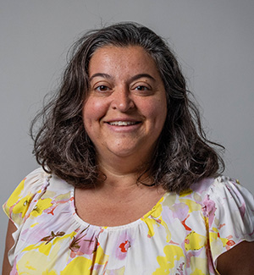
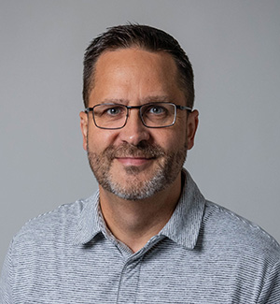
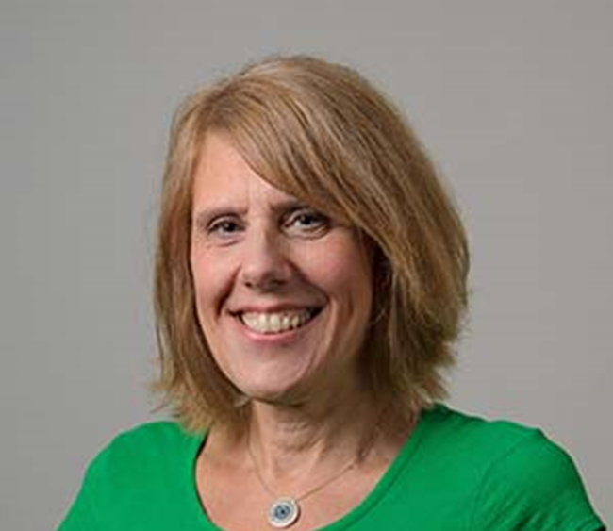
Safety Circuit Rider Team
Melissa Evans – Safety Circuit Rider
Jason Hughes – Safety Technical Associate
Lisa Knight – Educational Program Coordinator

Slide 3
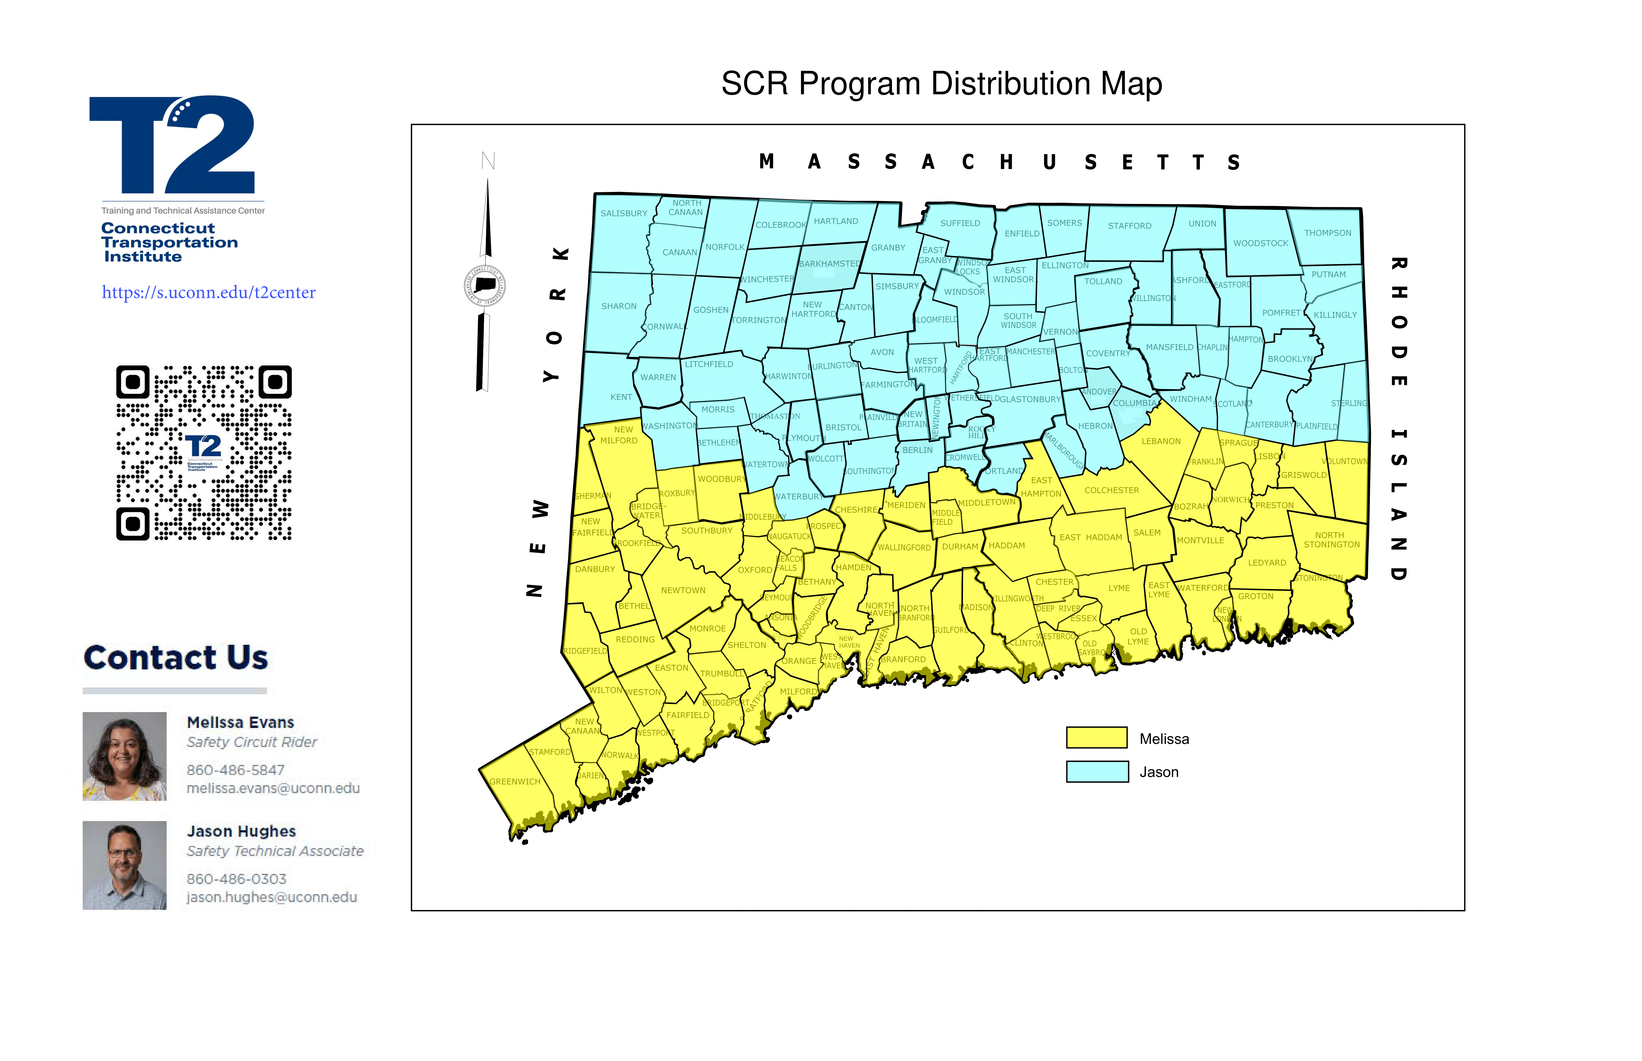
SCR Program Distribution Map

Slide 4
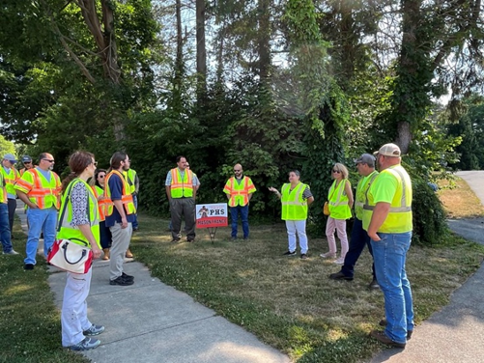
Many ways we can help!
Technical Assistance – Meet to discuss your road safety needs and help you develop your new Local Road Safety Plan
Road Safety Assessments (RSAs)
Crash Data Illustrations and Analysis
Training & Roundtable Discussions
Technical Resources
Coffee & Conversations on Hot Topics
Notes:
Melissa

Slide 5
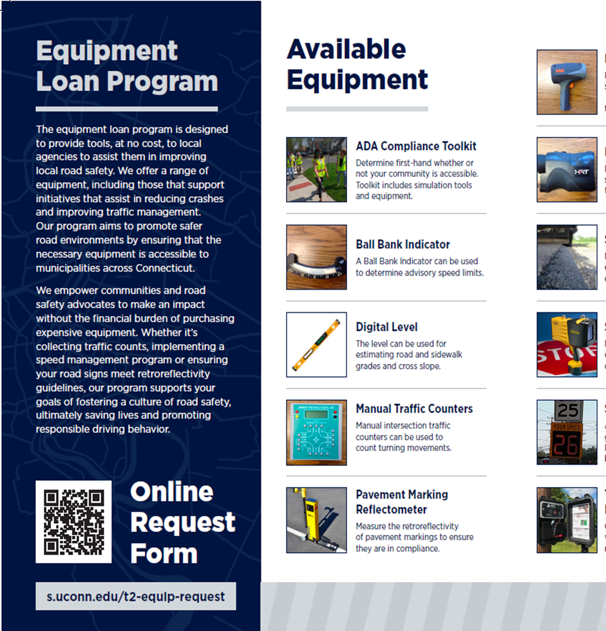
Free Equipment Loan Program
Sign Retro-reflectometer
Traffic Counters (Radar)
Ball Bank Indicators
Speed Feedback Signs
Range Finders
Radar Guns
NEW Pavement Marking Retro-reflectometer
Notes:
Jason

Slide 6
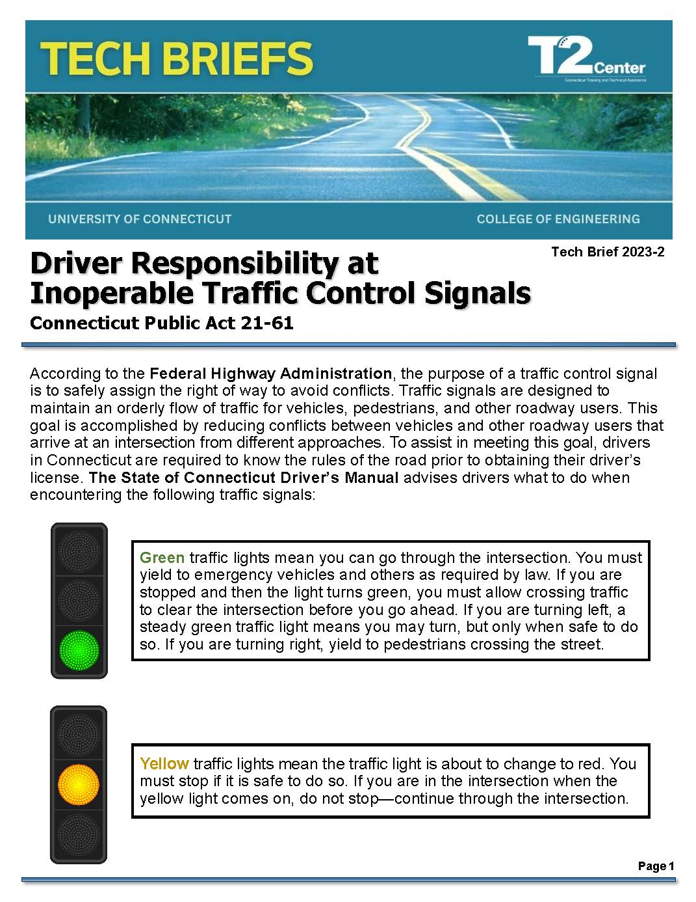
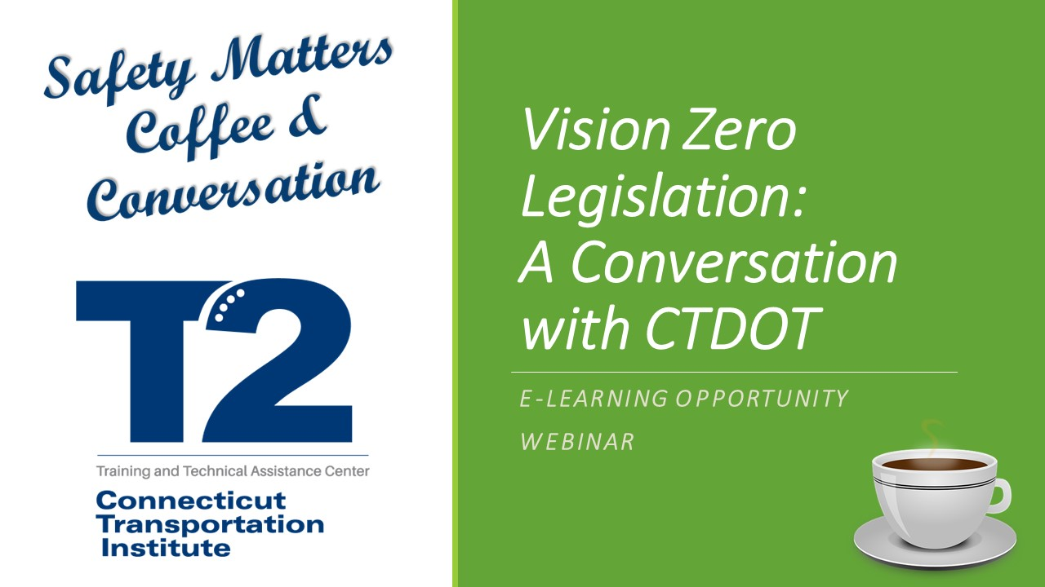
We Promote Safety

Slide 7
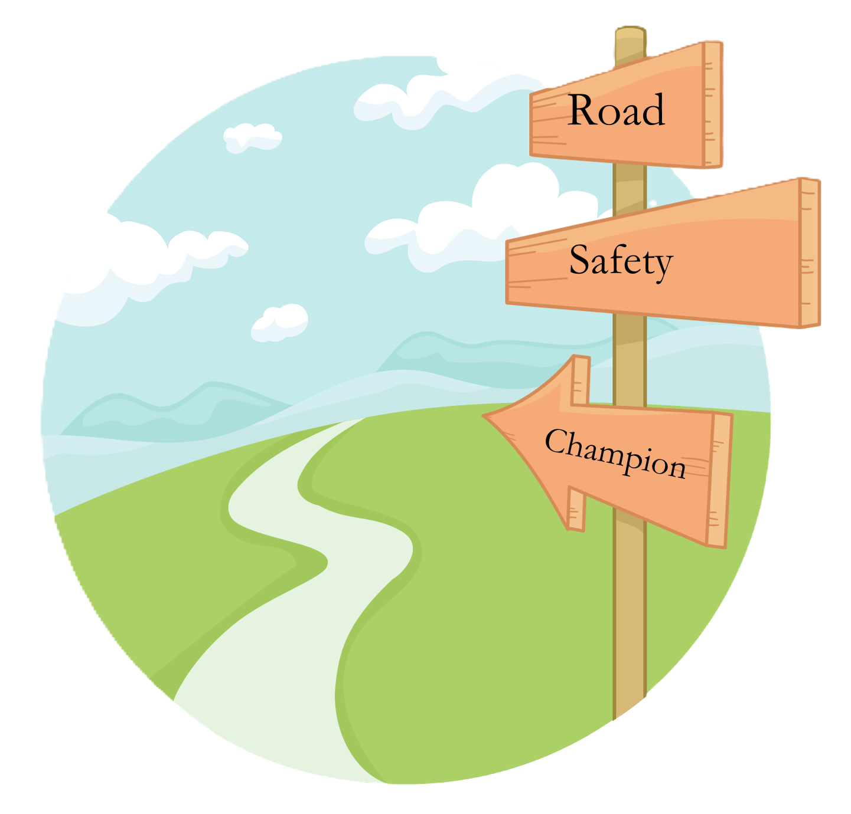
Become a Connecticut Safety Champion
Some of our Training Topics:
Low-Cost Safety Improvements
ADA Self-Assessments and Transition Plans
Safe Transportation for Every Pedestrian (STEP)
Speed Management
Roundabouts in CT
Sign Installation and Maintenance
Road Safety Assessments
Notes:
Jason

Slide 8
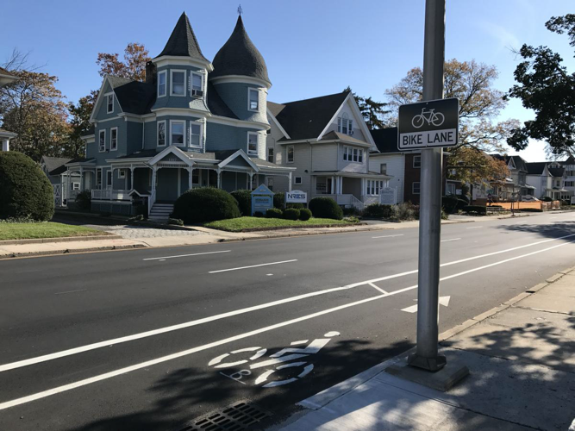
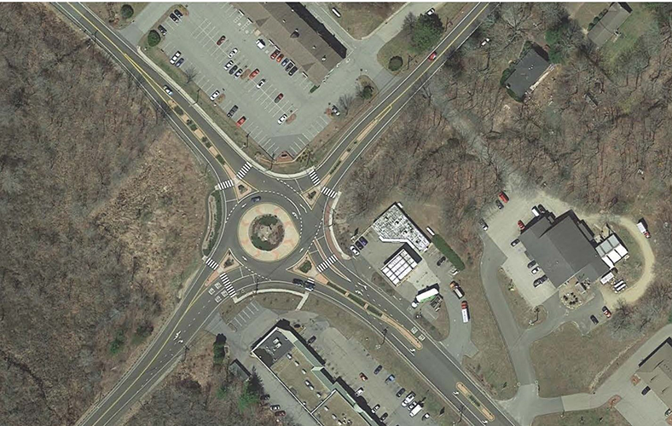
Connecticut Safety Examples Repository

Slide 9
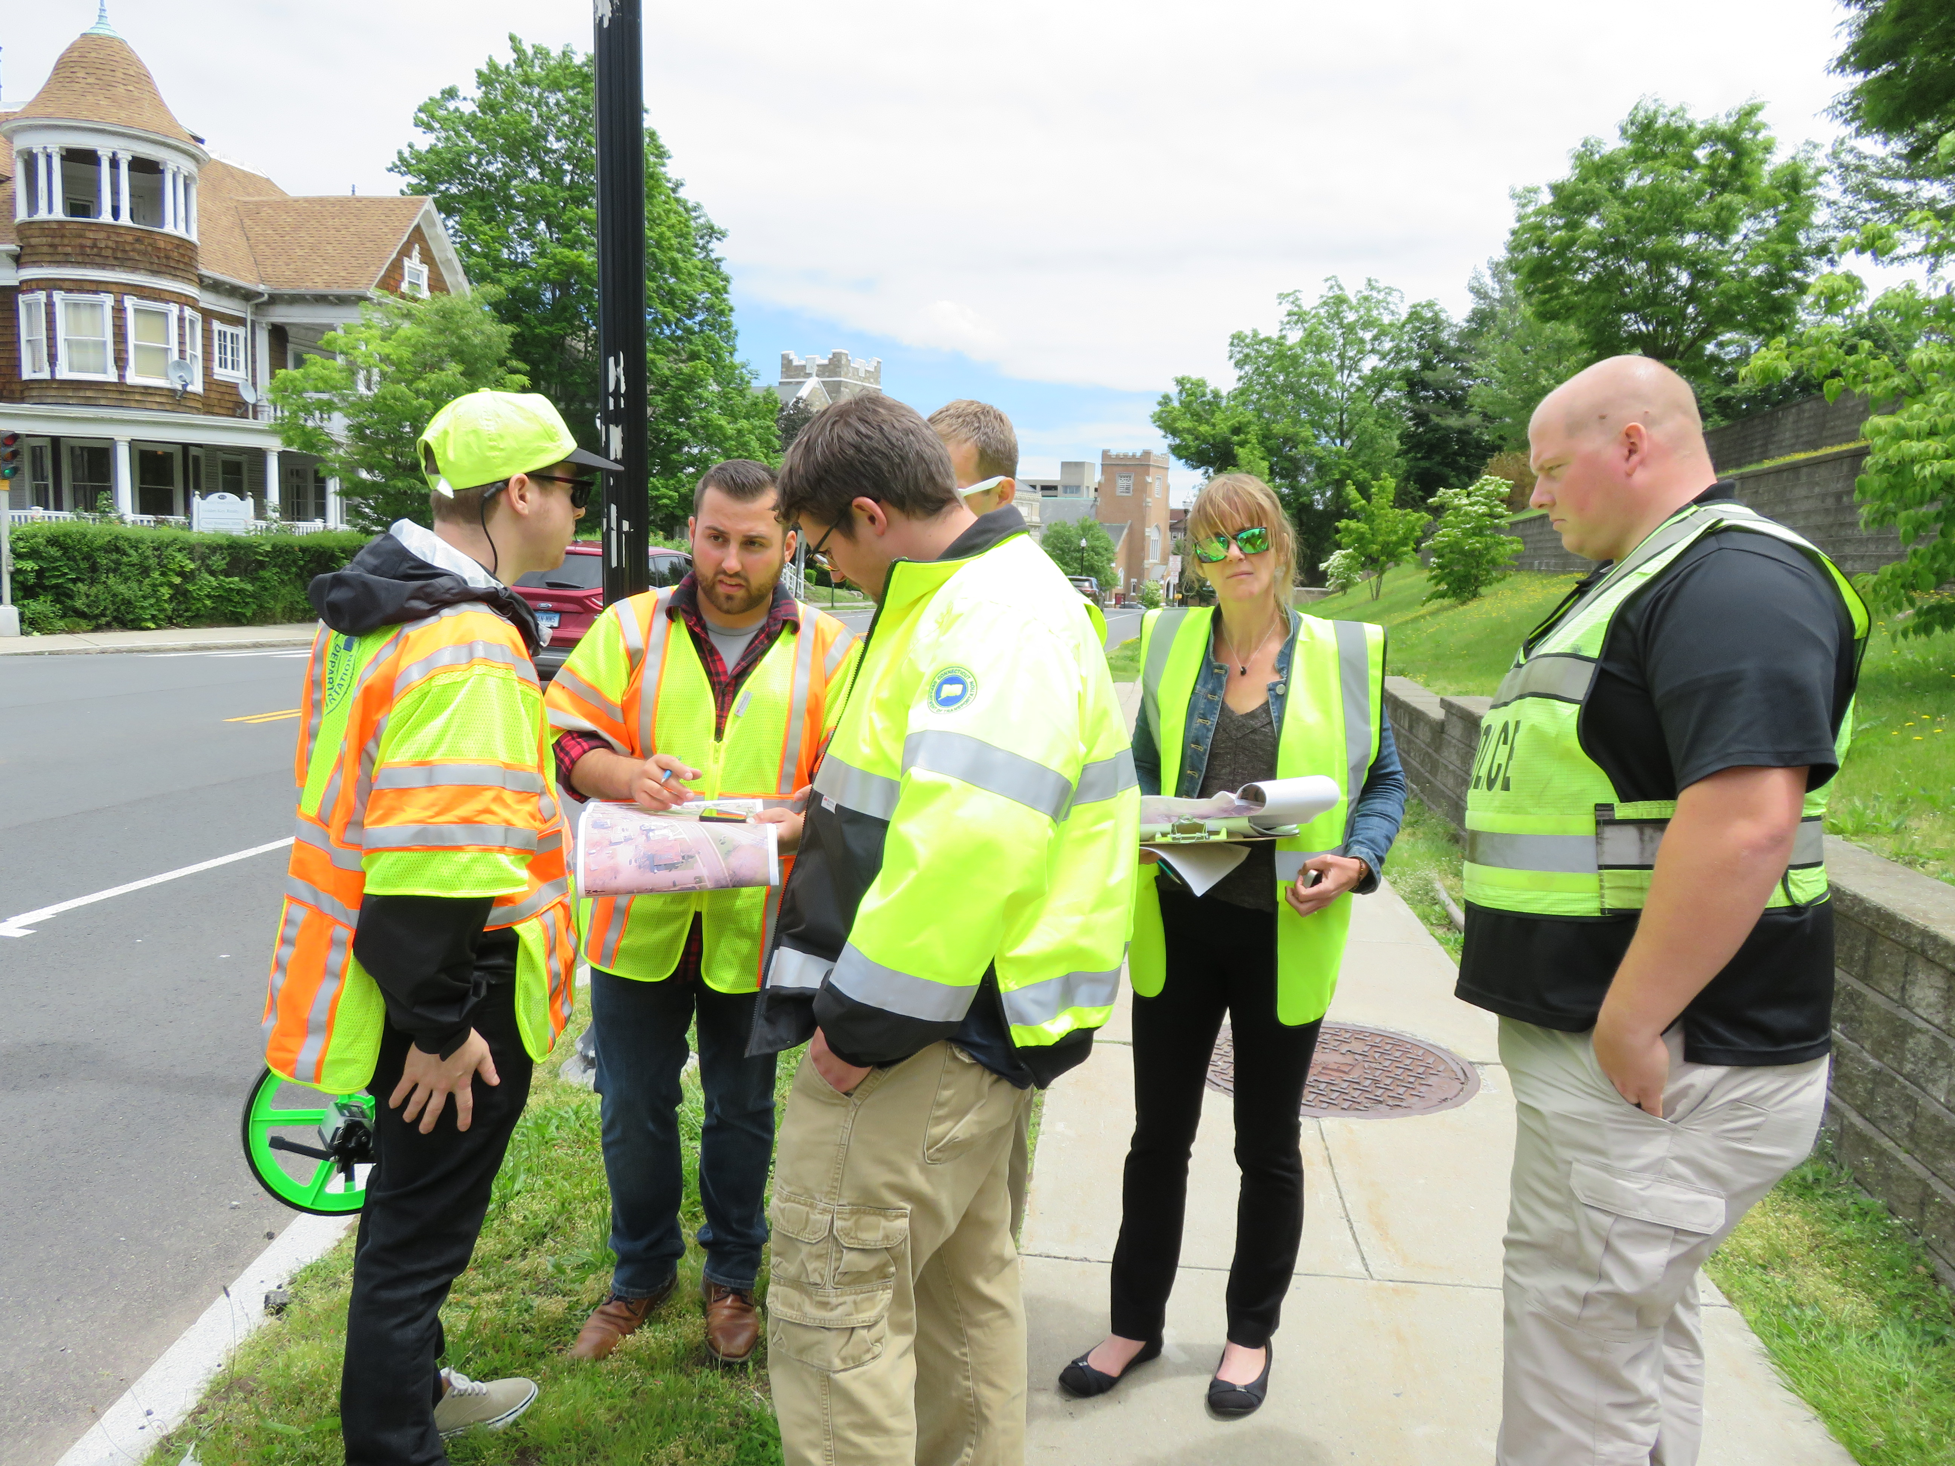
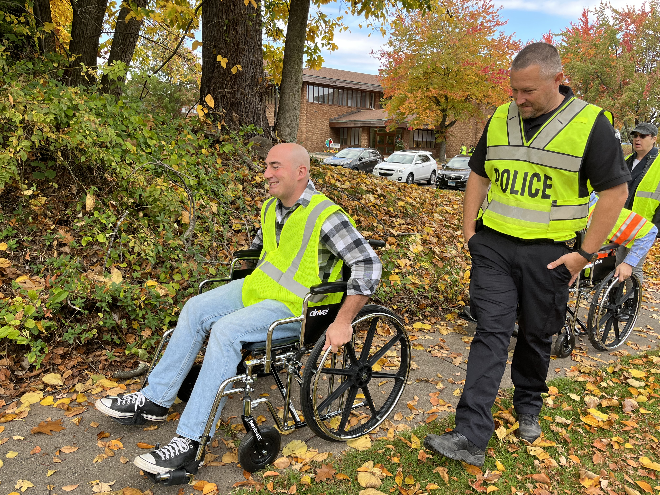
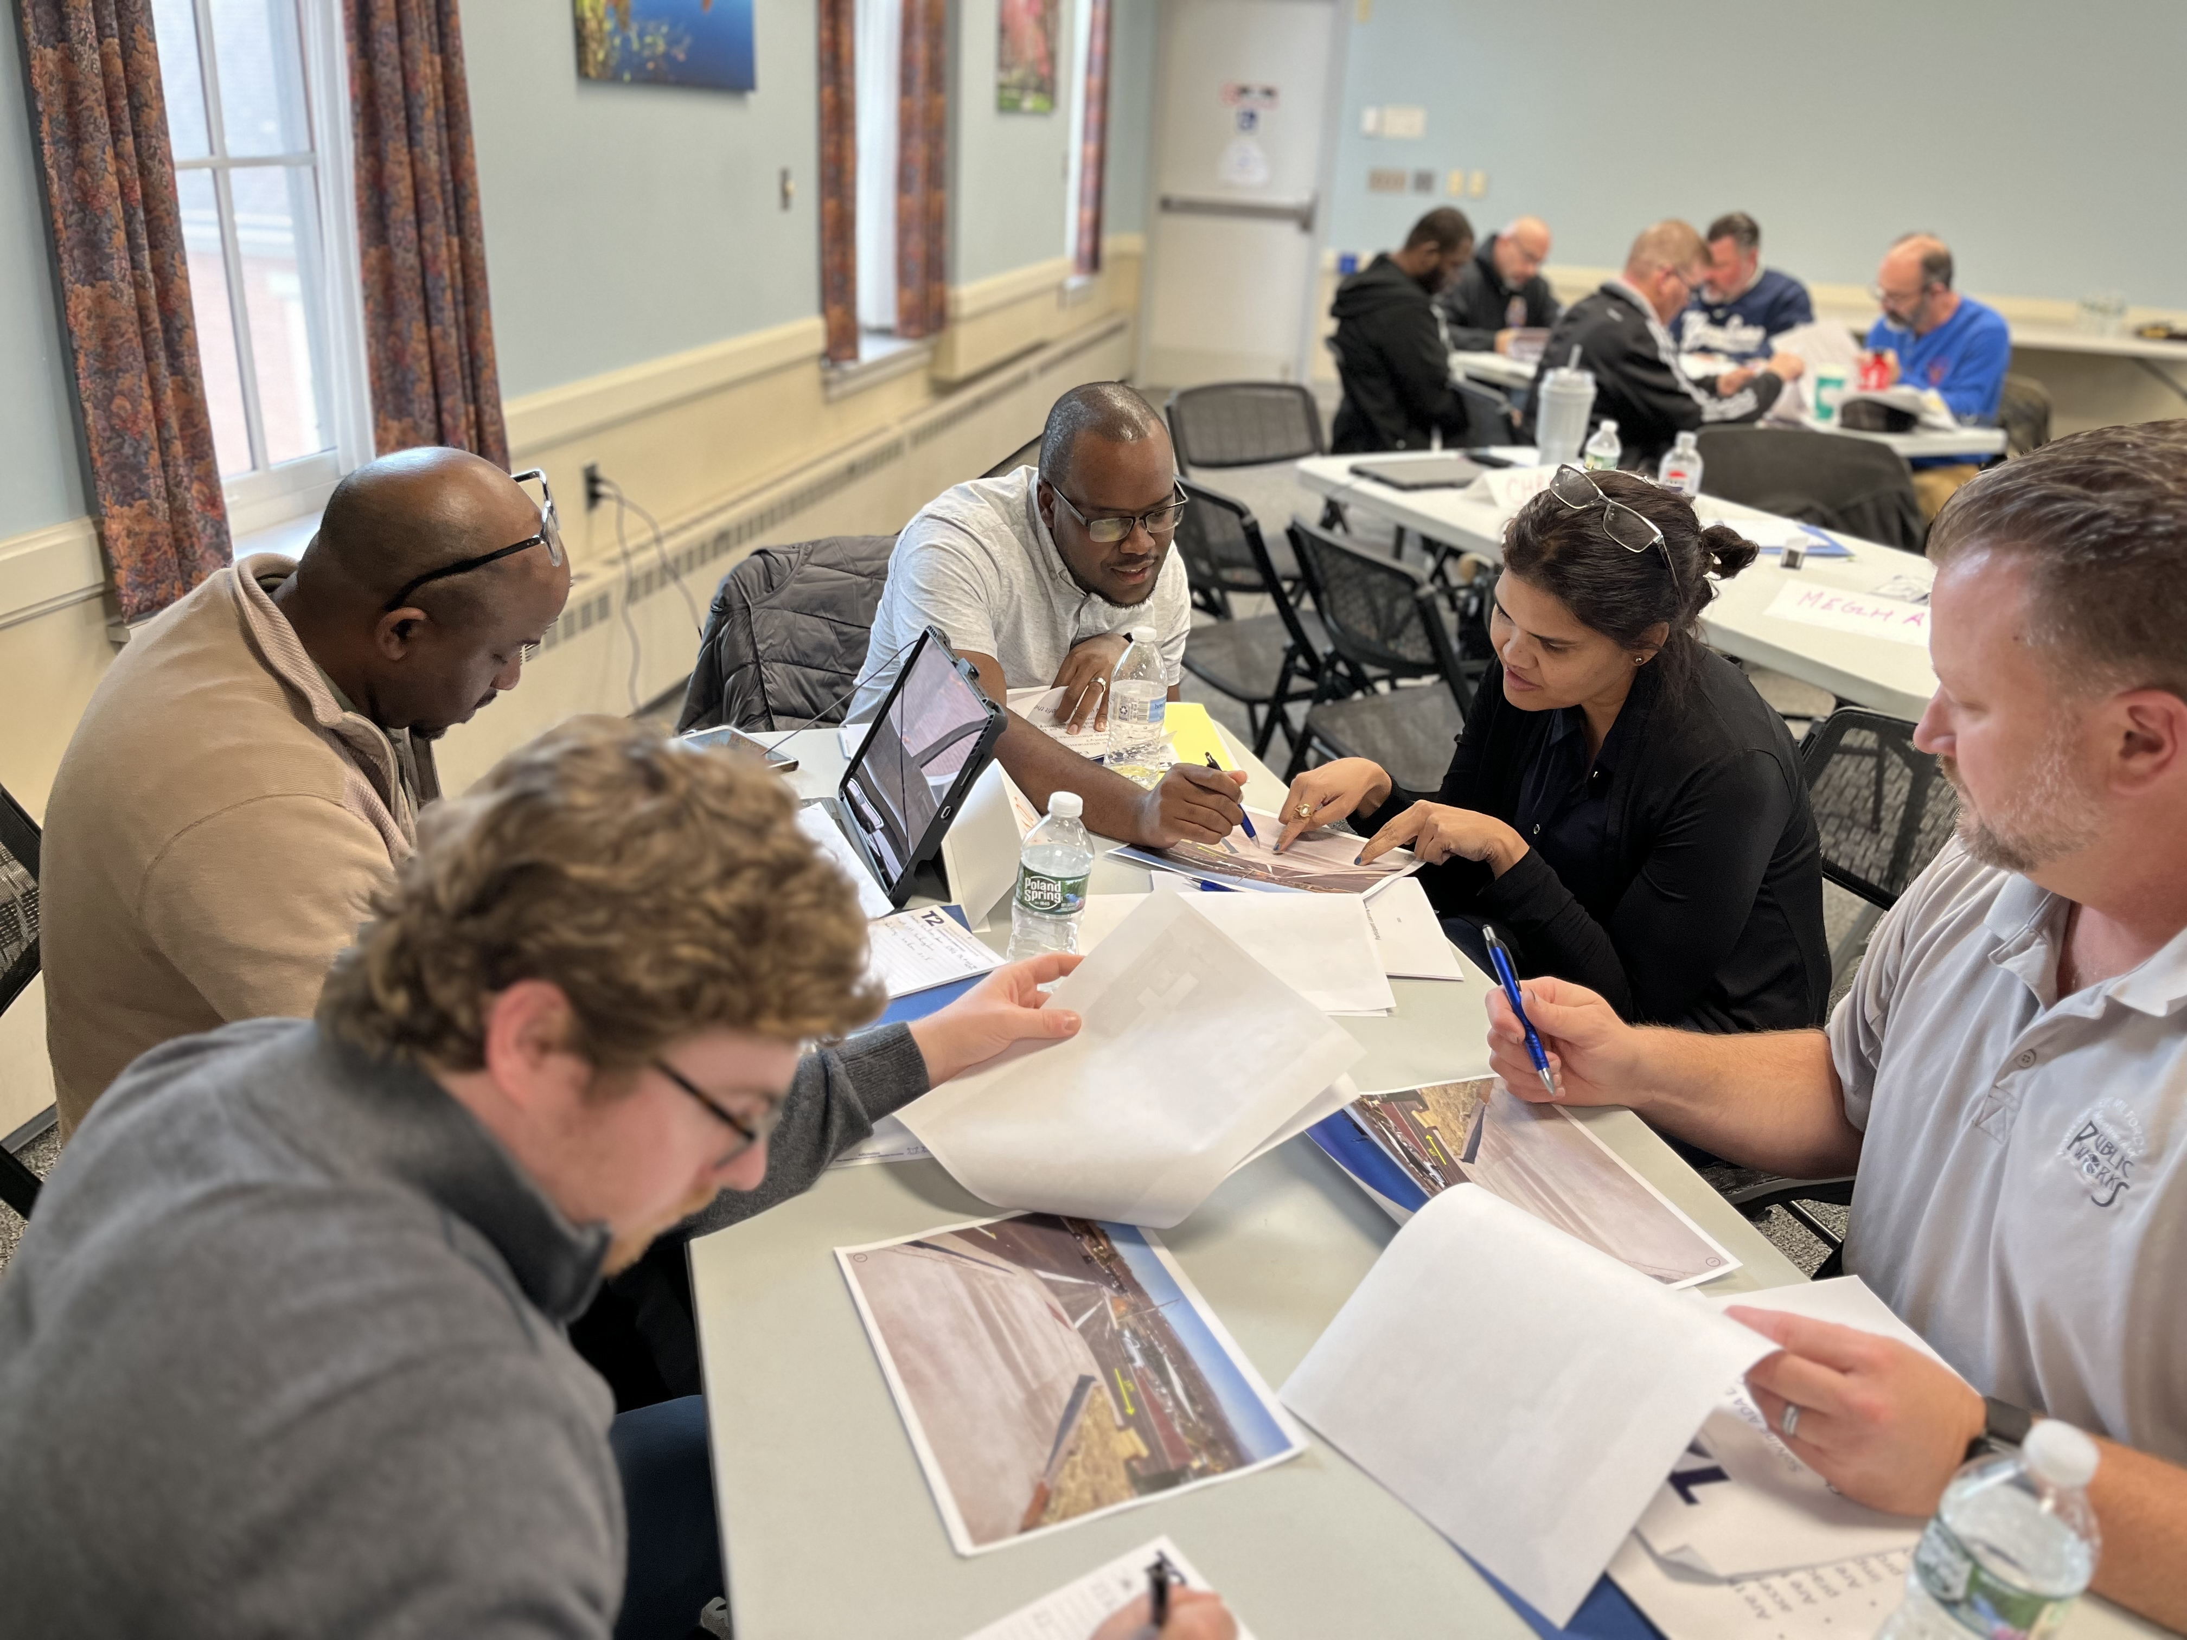
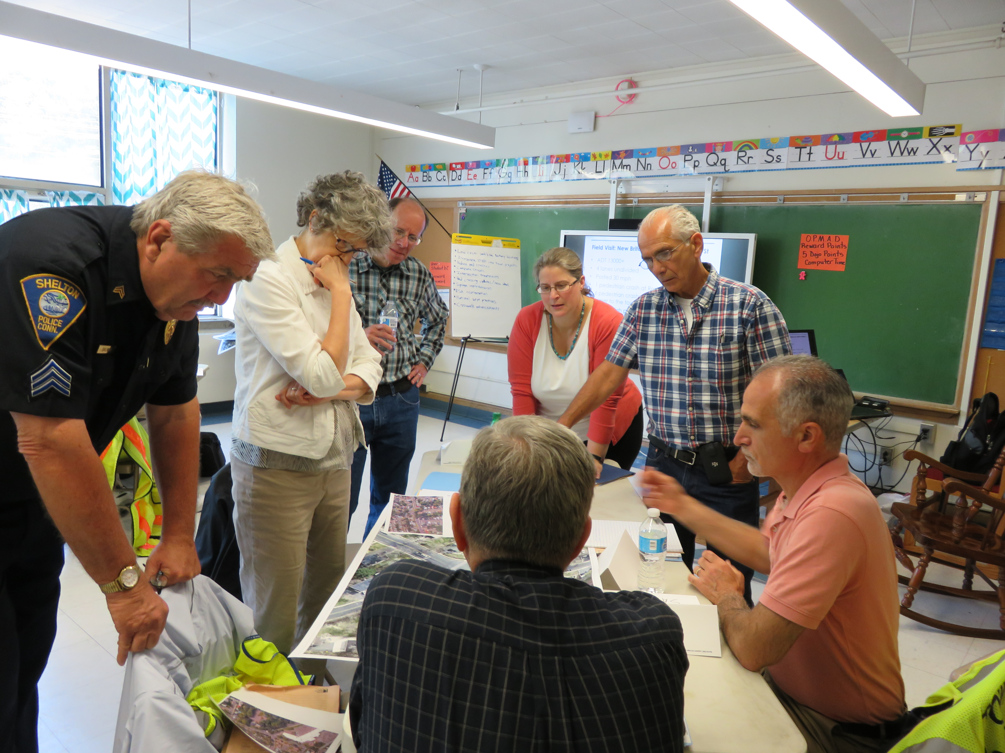
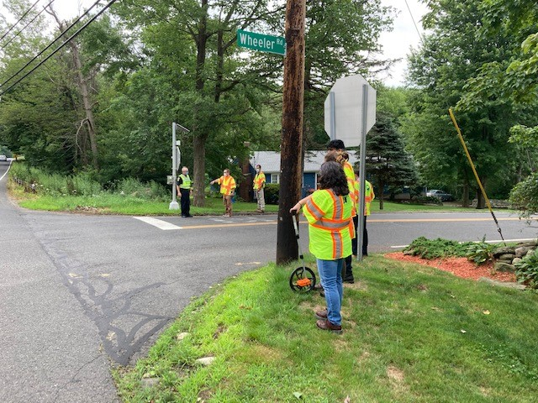
Let us Help!

Slide 10
Contact Information
Melissa Evans
Safety Circuit Rider
CT Training and Technical Assistance Center
University of Connecticut
Email: melissa.evans@uconn.edu
Phone: 203-898-0977
Jason Hughes
Safety Technical Associate
CT Training and Technical Assistance Center
University of Connecticut
Email: jason.hughes@uconn.edu
Phone:860-486-0303

