Slide 1
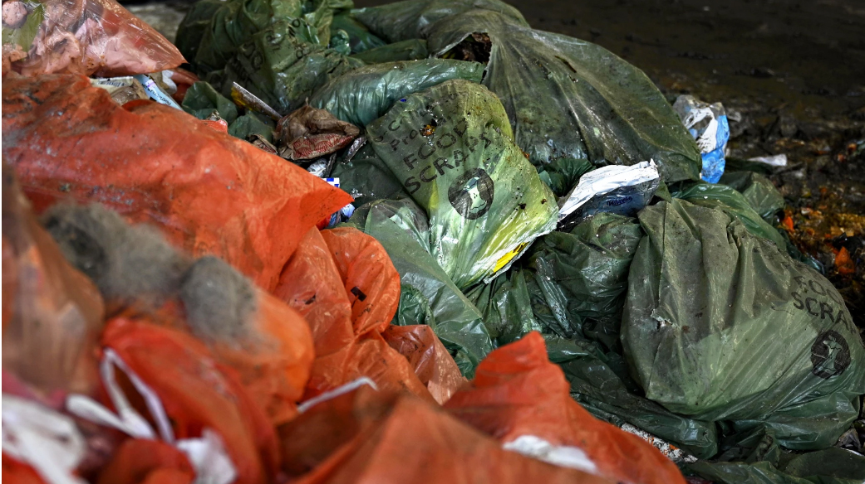
Middlebury Trash Reduction Program Community Champions Dinner
September 19, 2023

Slide 2
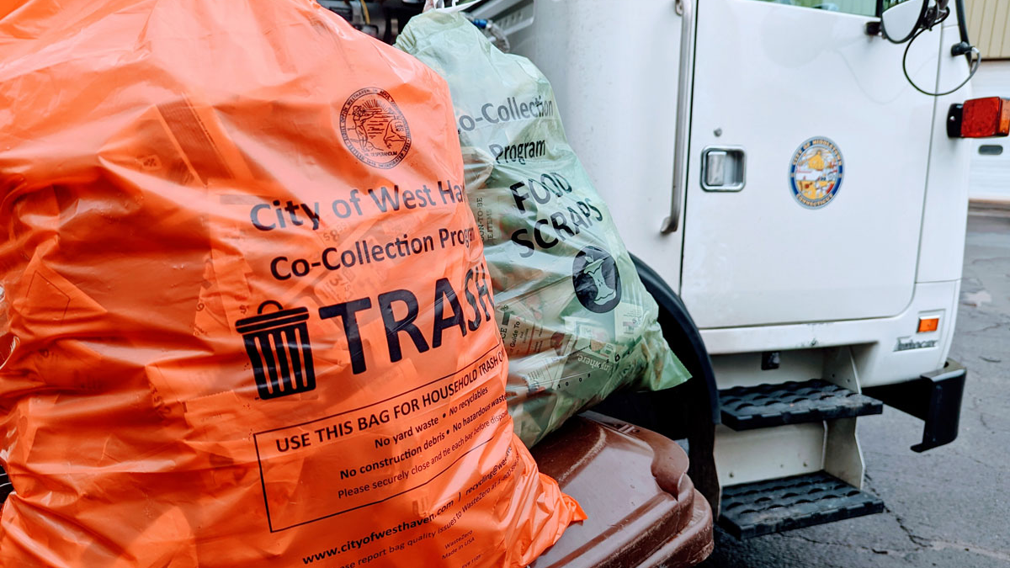
Introductions

Slide 3
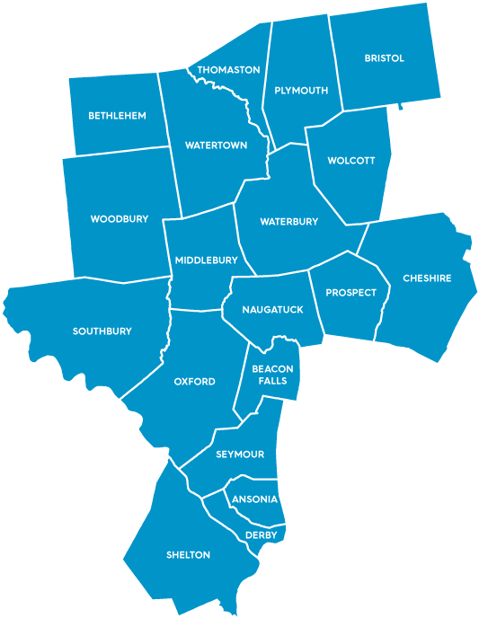
About Us
Naugatuck Valley Council of Governments (NVCOG)
Christine O’Neill, Environmental Planner & Tom Dougherty, Environmental Planner
Working with state & local partners on waste management

Slide 4
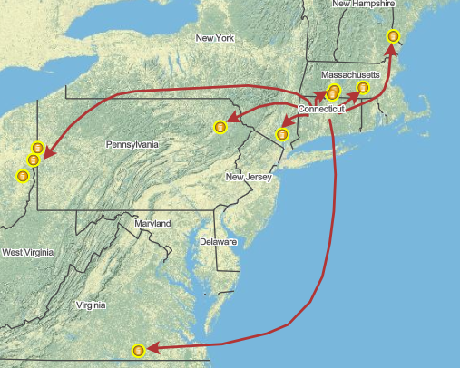
About the Problem
Connecticut is in a waste crisis.
Up to 40% of our waste is shipped out of state, due to a lack of disposal capacity. That means higher taxes, more emissions, and an uncertain future.
Our waste-to-energy incinerators are aging. All CT incinerators are approaching or past their 30-year lifespan.
Fees are skyrocketing. Industry experts predict that disposal rates will continue to increase well into 2050.

Slide 5
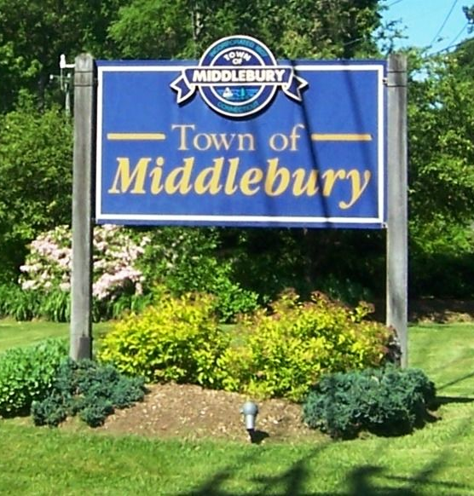
About the Problem
Middlebury’s 2023-2024 Annual Town Budget sets aside $476,277 for waste removal expenses – half a million dollars to get rid of our trash!
22-23 Budget: $429,629 (11% increase)
21-22 Budget: $396,233 (20% increase)
As capacity to deal with our waste shrinks, costs will rise for taxpayers.

Slide 6
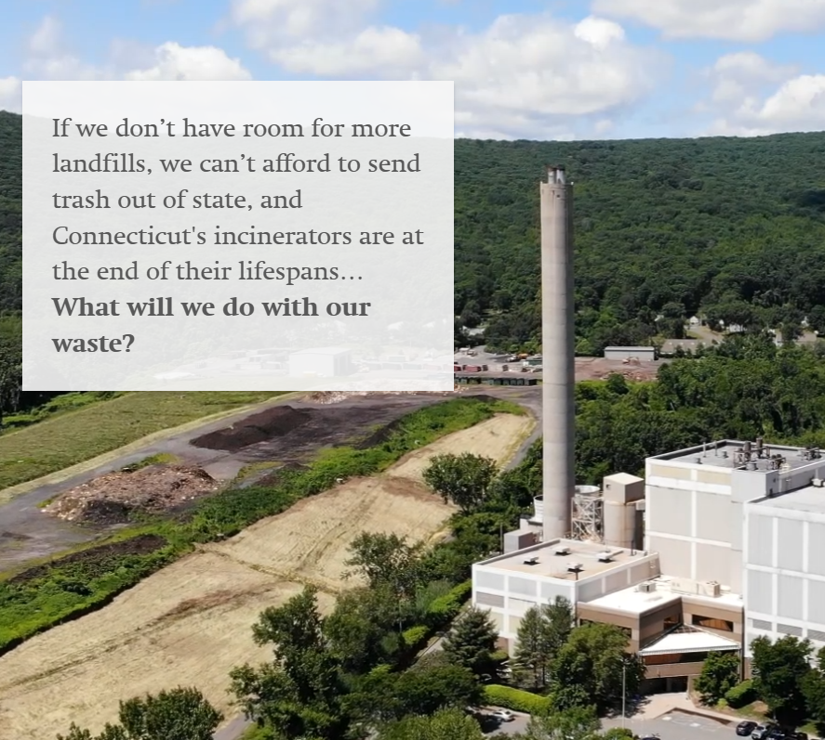
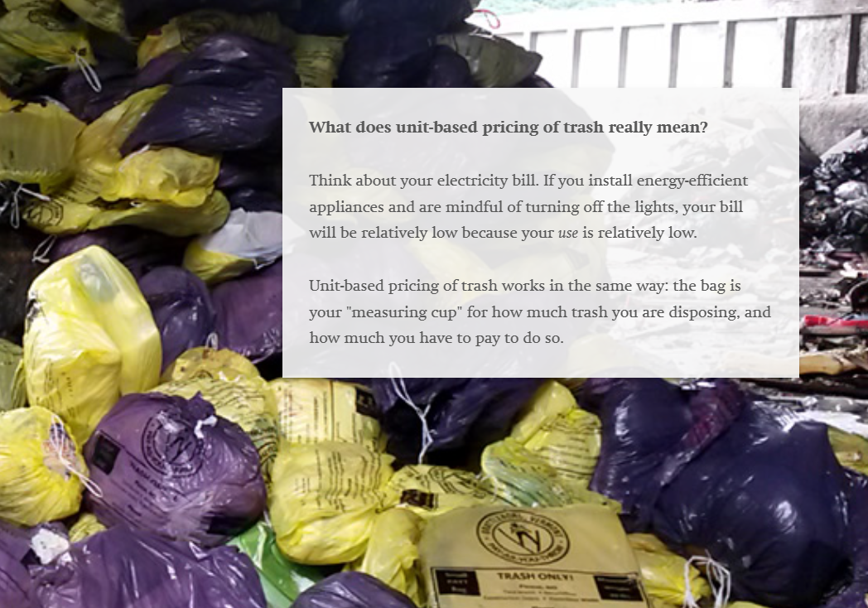
About the Problem
NVCOG created a Waste Crisis Storymap to help residents and decision-makers understand the problem.

Slide 7
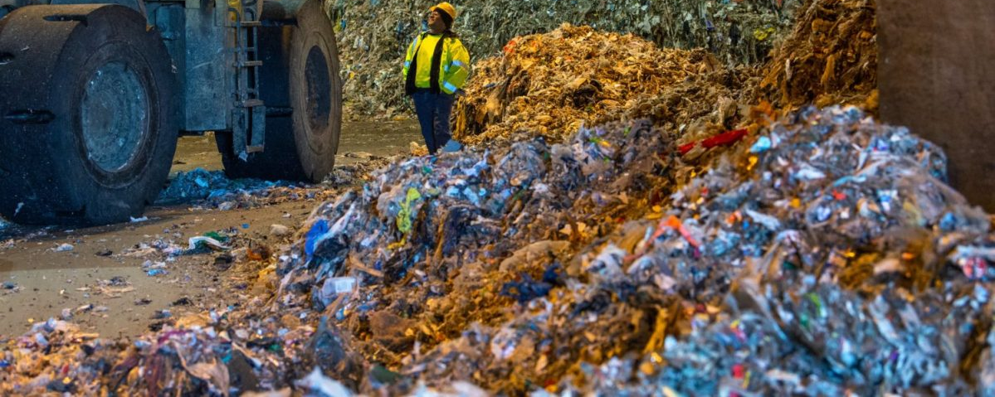
Program Goals
Mitigate rising costs
Save taxpayer $ on trash disposal
Reduce trash & pollution
Collect feedback & data to prove that this program should become permanent
Cut the trash in half!

Slide 8
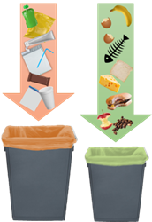
About the Program
Funded by a CT DEEP Sustainable Materials Management (SMM) Grant
2 key components:
Organics diversion
Unit-based pricing
Only households that use the transfer station are eligible for the pilot.
Proven cost-effective & sustainable solutions
These strategies are used all over the world.
Middlebury is joining 15 other communities in CT that already have similar pilots running.

Slide 9
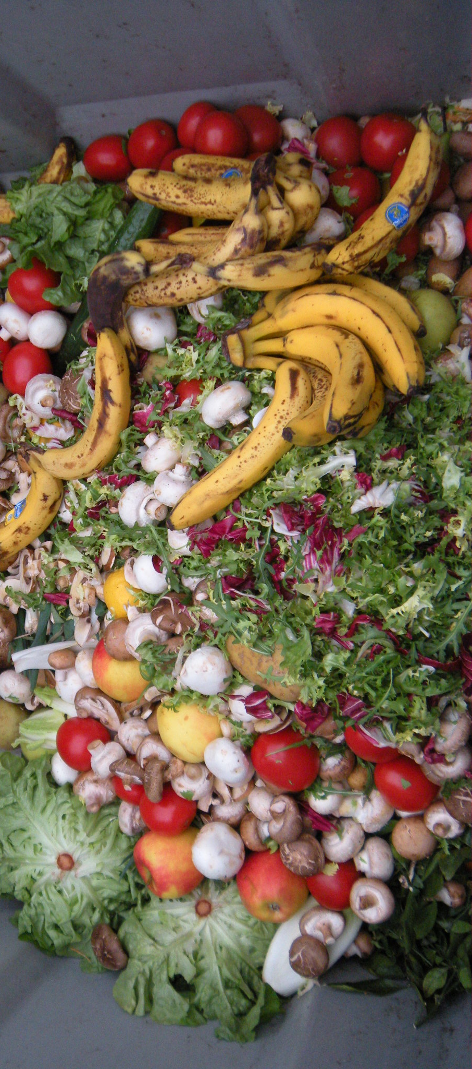
About the Program: Organics Diversion
22% of Connecticut’s waste is food scraps.
Food scraps are heavy & expensive to transport.
In landfills, they emit more greenhouse gases (methane) than any other material. In incinerators, their wetness makes them inefficient to burn.
Separating food scraps for anaerobic digestion allows us to get energy from waste without burning it!
We also pay less money (lower tipping fee than trash), because the revenue from selling energy to the grid offsets the digestor’s costs.

Slide 10
About the Program: UBP
During the pilot, no one will pay for the initial year’s supply of bags.
Middlebury is piloting a type of Unit-Based Pricing system by using the bags as "measuring cups." UBP would involve a per-bag charge where you only pay for what you use, like how we pay for utilities.
If you make less waste, you pay less money! A positive incentive for residents, and everyone pays a fair share.
At the end of the pilot, the grant consultant (Waste Zero) will model paths forward that involve UBP. Middlebury leadership will decide if it makes sense financially, logistically, and sustainably.

Slide 11
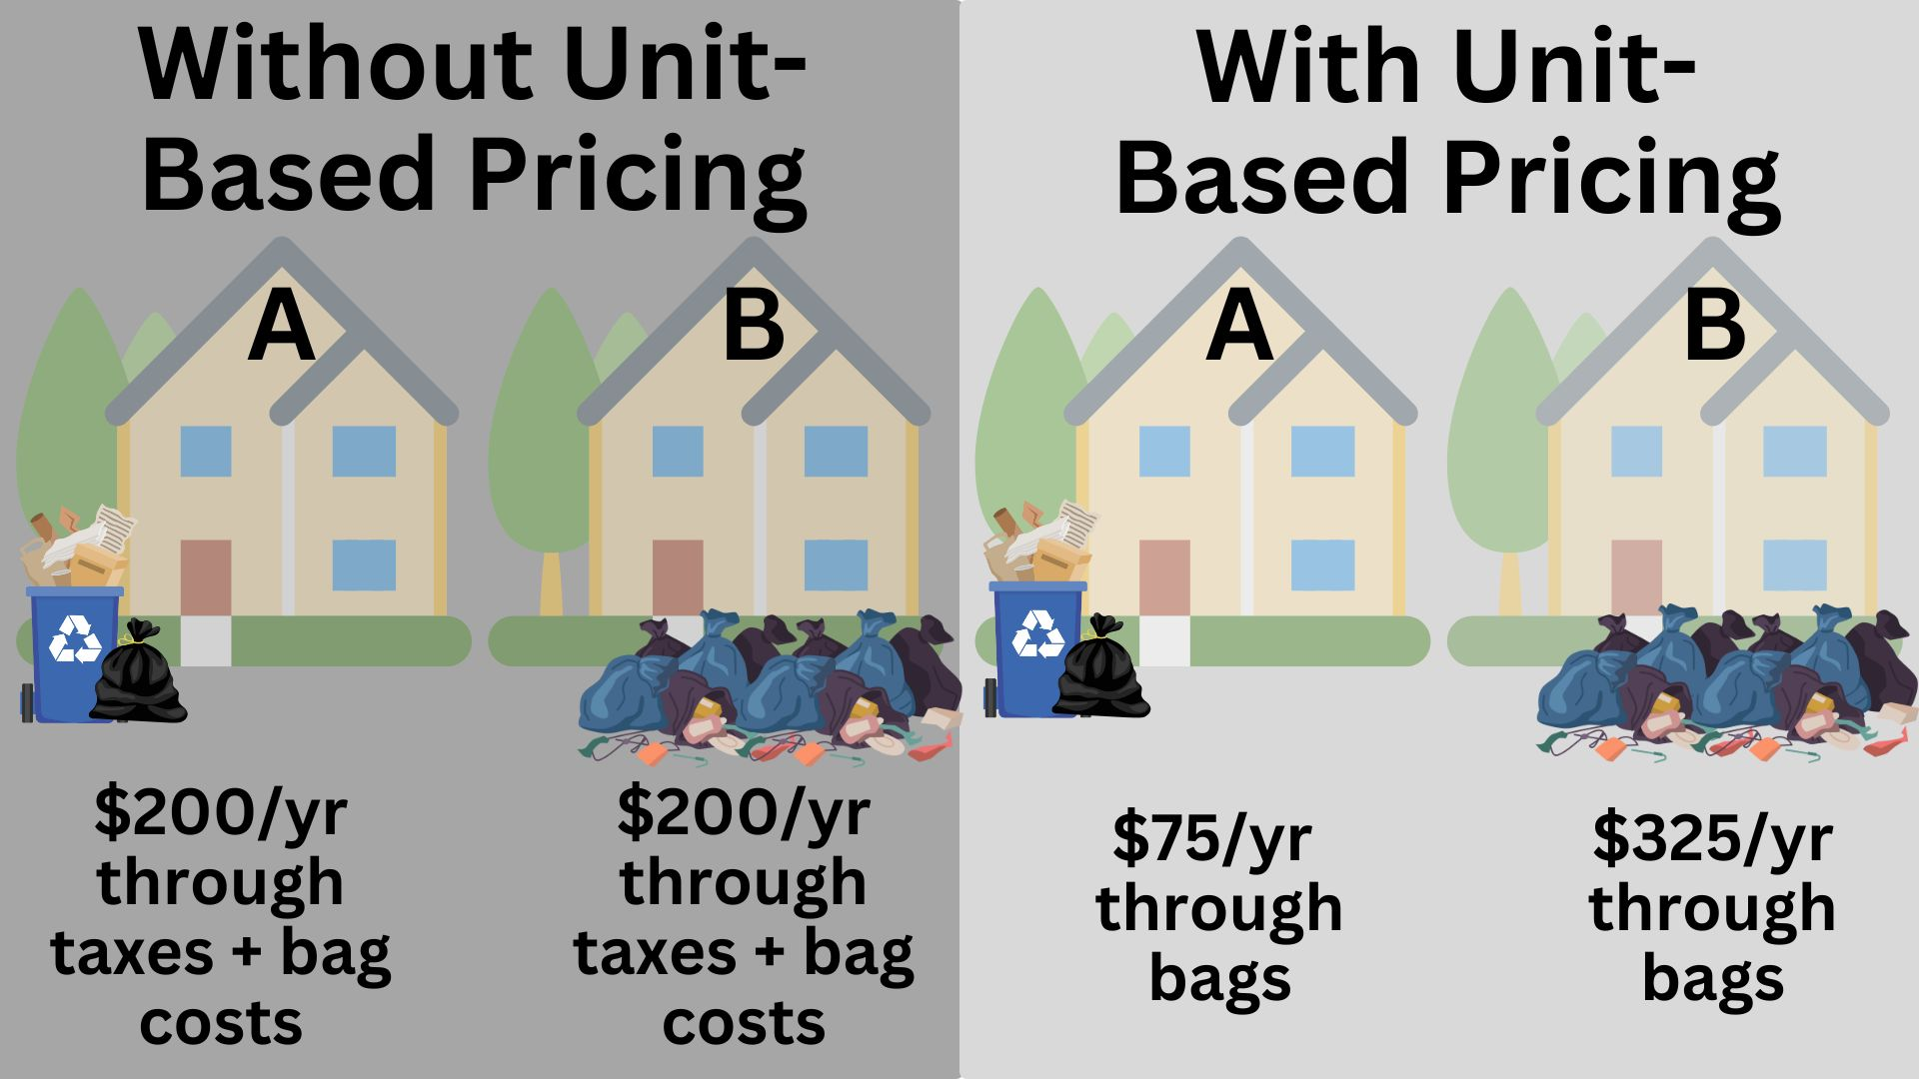

Slide 12
How the Pilot Works

Slide 13
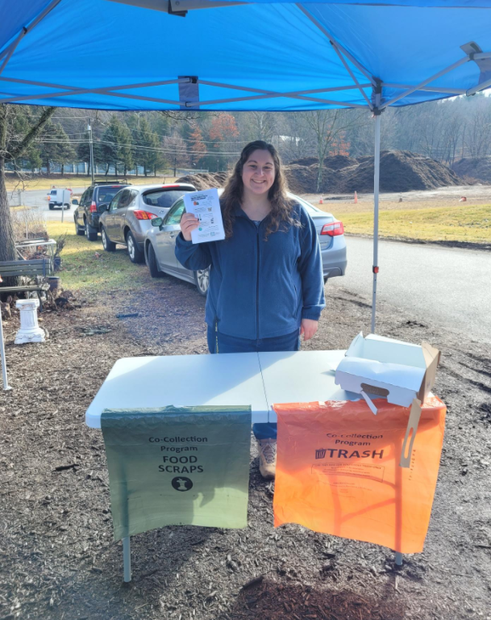
Step 1: Get your bags
Boxes of bags were handed out from late June to late July.
Ask an attendant for bags if you miss the initial handout.
You’ll get a box with…
104 orange bags
52 green bags
Info sheets
This supply should last a full year! 2 orange & 1 green per week.

Slide 14
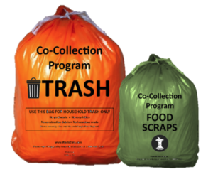
Step 2: Separate waste into green and orange bags
Regular trash goes in the orange bags. These replace your black or white bags!
Unpackaged food scraps go in the green bag. If you already compost, keep doing that.

Slide 15
Woodbury is down to only 2% contamination in their green food bags… a little friendly competition with Middlebury, perhaps?

Slide 16
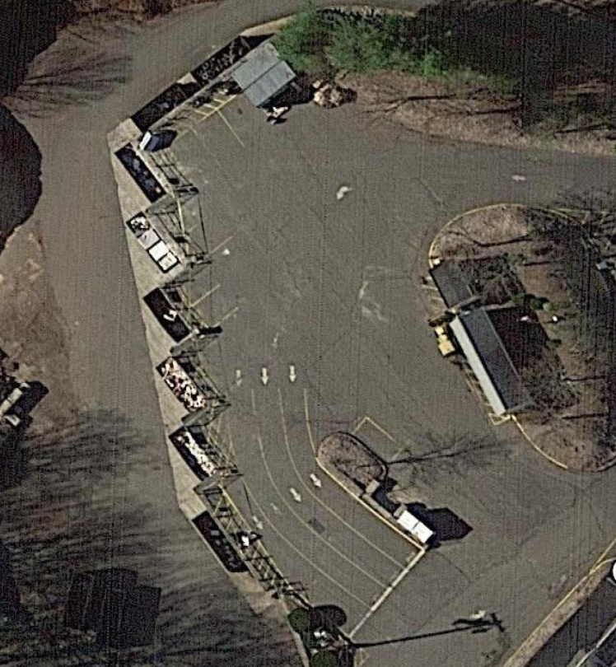
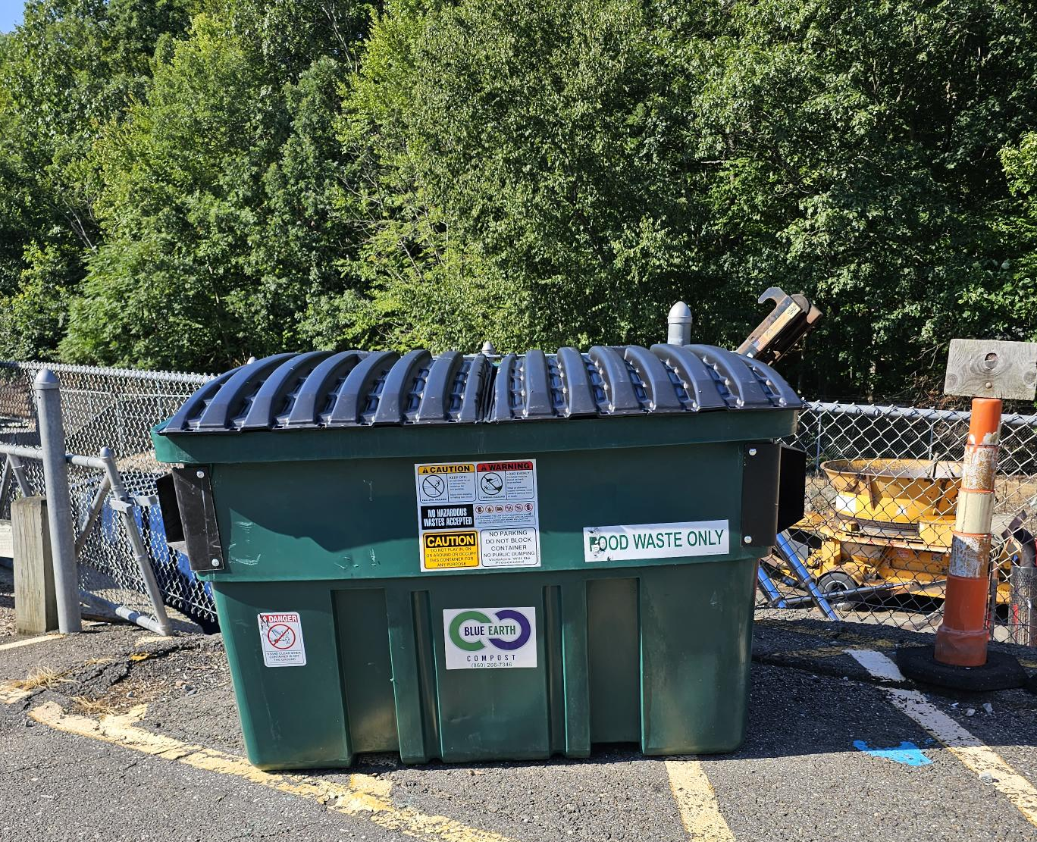
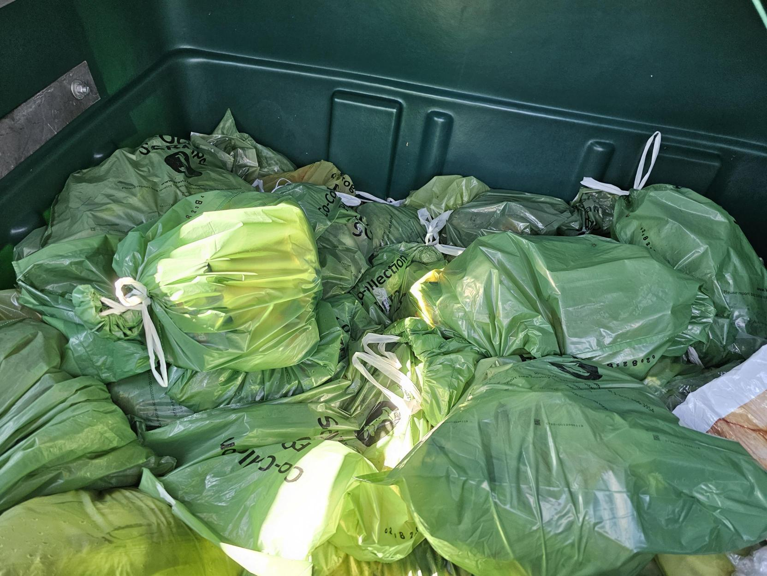
Step 3: Normal dumpsters for orange, new container for green

Slide 17
Step 4: Food scraps get turned into clean energy
Orange bags are hauled to their normal disposal destination
Green bags go to Quantum Biopower in Southington
Anaerobic digestor produces renewable energy + byproducts like mulch from organic waste

Slide 18
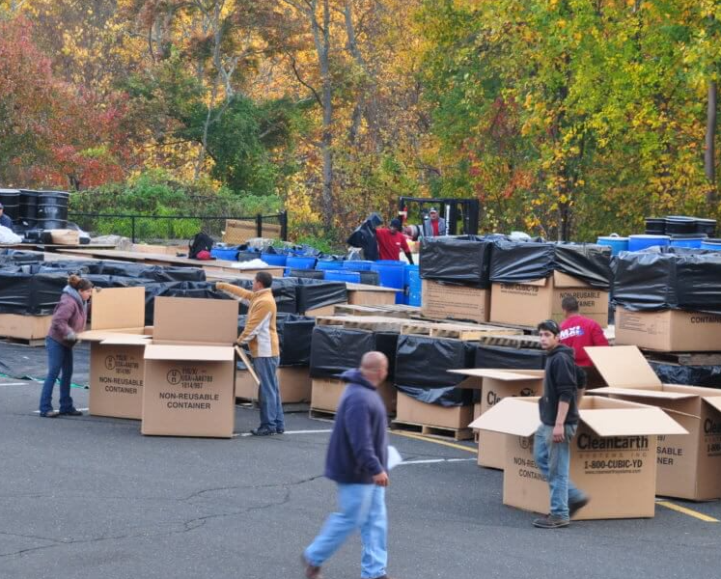
Complementary Efforts
This program is an opportunity to promote other sustainable waste management strategies:
Improved & increased recycling
Household Hazardous Waste Collections
Changing habits & behavior to reduce consumption

Slide 19
Frequently Asked Questions
Notes:
KATIE

Slide 20
FAQs
What happens if I run out of bags?
Your free box gives you enough to use 2 orange trash bags/week and 1 green food scrap bag/week for a full year. Help us cut the trash in half by sticking to that number. If you run out, call the number on your materials to see if we have more available.
Will my food scraps attract rats/bears/critters?
Remember that separating your organic food waste into its own green bag *does not* involve creating any new food waste. So if you didn’t have an issue with this before the pilot program, you shouldn’t have an issue with it now! Be sure to keep your green food scraps bag in a sealed container (whether that’s your trash can or another container in your kitchen).

Slide 21
FAQs
Has this sort of program been successful in other communities?
Unit-based pricing and organics diversion is being done all over the country and all over the world! From Minnesota to Taiwan, we have seen these program effectively reduce waste and save money.
These bags aren’t the right size…
During this “one size fits all” pilot, you may find that the bag sizes don’t suit your household’s needs. Program architects are aware, and will certainly consider multiple size options for a permanent version of the program.
Notes:
CHRISTINE

Slide 22
FAQs
What happens if this program becomes permanent?
If the pilot data justifies a permanent program, here’s what may change:
The fee for waste disposal could be transferred (completely or in part) from property taxes to a per-bag charge. Residents would pay for each bag they use. That means if you make less garbage, you pay less money!
Data suggests that a permanent program could save Middlebury around $100,000 annually.
These projections are based on the goals of the grant. We won’t know for sure what a permanent program looks like until Middlebury leadership puts a proposal on the table.
Notes:
CHRISTINE

Slide 23
Questions?
Notes:
KATIE

Slide 24
Next Steps

Slide 25
Keeping up the momentum
Spread the word!
Speak up where there’s misinformation or confusion.
Follow NVCOG Reduce the Trash on FB, the Town of Middlebury, community groups, etc. and stay informed.
Bring this message back to other groups you are part of (PTA, Girl Scouts, Garden Club…).
Notes:
KATIE
We need all hands on deck to spread the word about this program. Encourage your neighbors, friends, and colleagues to give it a shot!
Speak up when there’s misinformation or confusion – Facebook groups, conversations, op-eds, etc.
Follow the NVCOG page, the City of Ansonia page, ReduceTheTrashCT page, and join community social media groups.
Bring this message back to any other group you are a part of (PTA, Girl Scouts, Garden Club, etc.)
6 and 8 Colony St

Slide 26
Resources
Info sheets that come with your bags
www.ReduceTheTrashCT.com/Middlebury
RecycleCT App or website
NVCOG’s Waste Management webpage
“We Are In A Waste Crisis” Storymap
Facebook @NVCOGReduceTheTrash
ReduceTheTrash@nvcogct.gov or 203-489-0351

Slide 27
Ideas? Questions?

Slide 28
Keep in touch!
ReduceTheTrash@nvcogct.gov
203-489-0351
Thank you for joining!

