Slide 1
Pequabuck River Trail Study
May 24, 2023

Slide 2
Meeting Agenda
Introduction
Project Background
Study Process
Routing Recommendations
Implementation Strategies
Public Comment

Slide 3
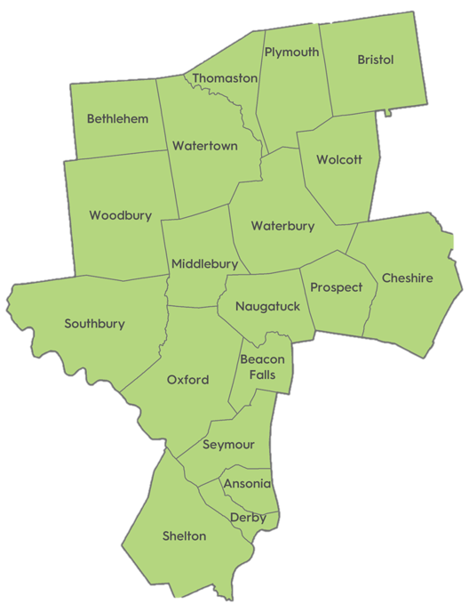
What is NVCOG?
Naugatuck Valley Council of Governments
Voluntary association of 19 municipalities
Municipal CEOs - NVCOG Board
Federally designated Metropolitan Planning Organization (MPO) - Transportation
Transportation planning, land use planning, environmental planning, and more

Slide 4
Why are we doing this?
In support of City of Bristol's efforts to create a transformative recreational space/active transportation corridor
Economic development -- revitalize West End neighborhood
Ensure safe + accessible way for non-motorized users to travel
Reconnect residents to the Pequabuck River
This routing study, along with recently awarded design funds, will put the City in a strong position to apply for grants for construction

Slide 5
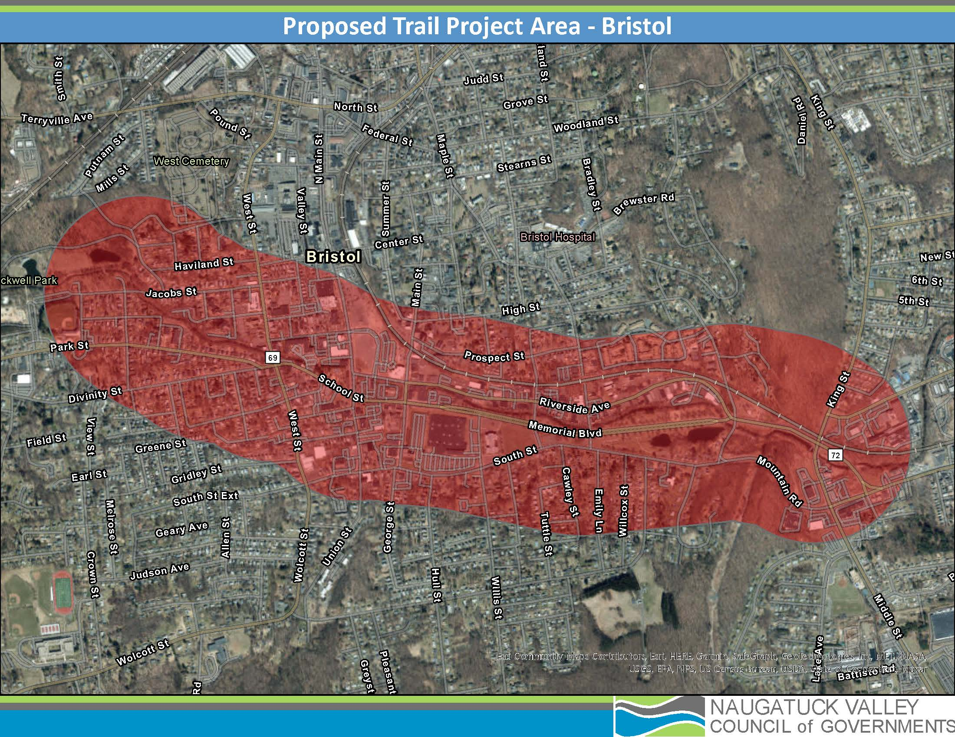
Study Area
Segment 1: Rockwell Park to Brackett Park
Segment 2: Brackett Park to 229 (along Memorial Blvd)

Slide 6
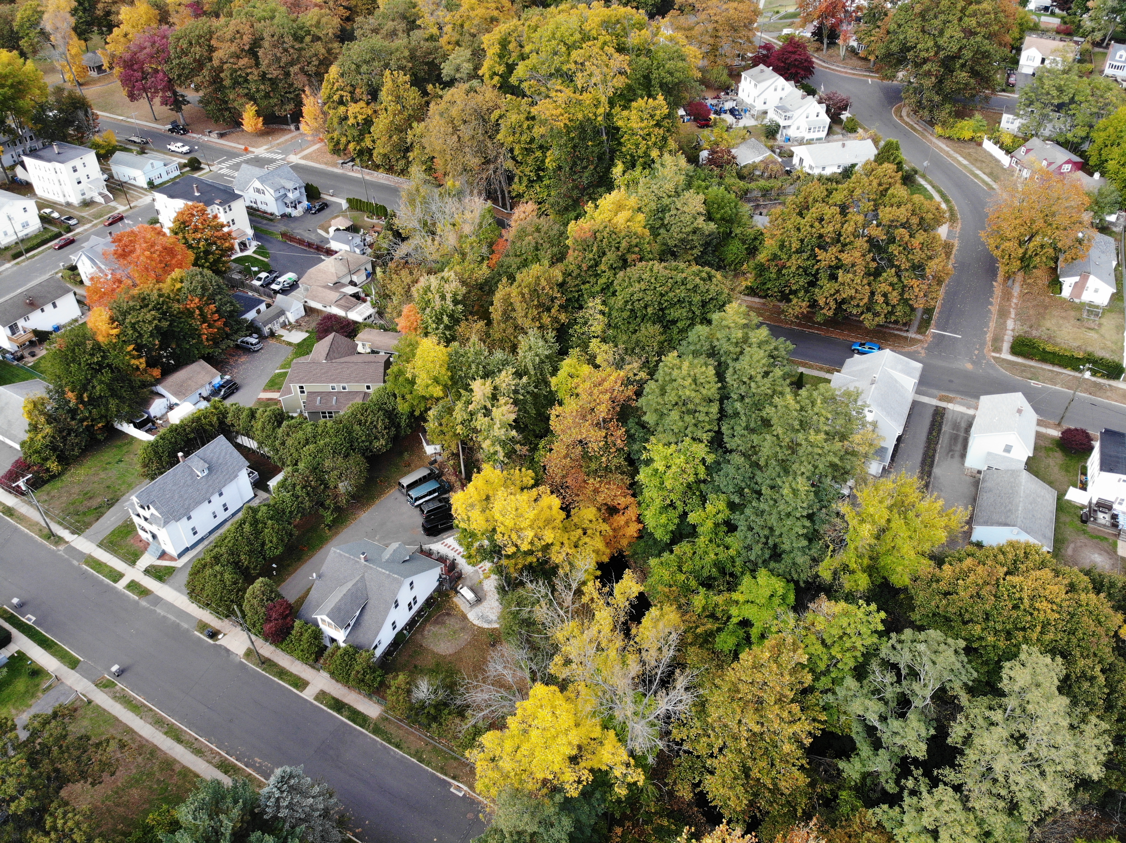
Notes:
Pic 1) just SE of rockwell park
Pic 2) same, just facing the other way
As you can see, there is a very limited connection to the pequabuck for recreation.
Despite urban density of Bristol, there is this fantastic natural feature – we want to provide everybody access – Bristol already has a beautiful underutilized natural asset

Slide 7
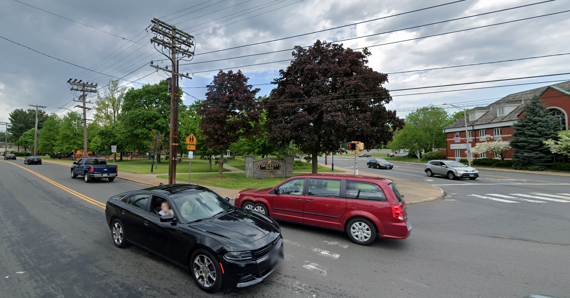
Notes:
Pic 1) Bracket Park (School St/North Main St)
Pic 2) Riverside Ave at Rt. 229
The section of memorial blvd linking these two locations currently has an on street, unprotected mobility/bike lane, which is we are currently planning to keep for this section of trail.
Toward the end of this section (near Rt 229), there is some ROW in between the River and Riverside Ave.

Slide 8
Background
Existing Conditions
Current limited pedestrian/bicycle access to downtown Bristol
Route 229 study – North/South
Memorial Blvd mobility lane
Community Investment Fund – Route 72
Route 69/72 Project
Route 72/Riverside Ave realignment
Project concept + goals
Create safe and continuous east-west active transportation corridor in Bristol – from Rockwell Park to Route 229
Notes:
Happening in conjunction with many other complete streets improvements throughout the city

Slide 10
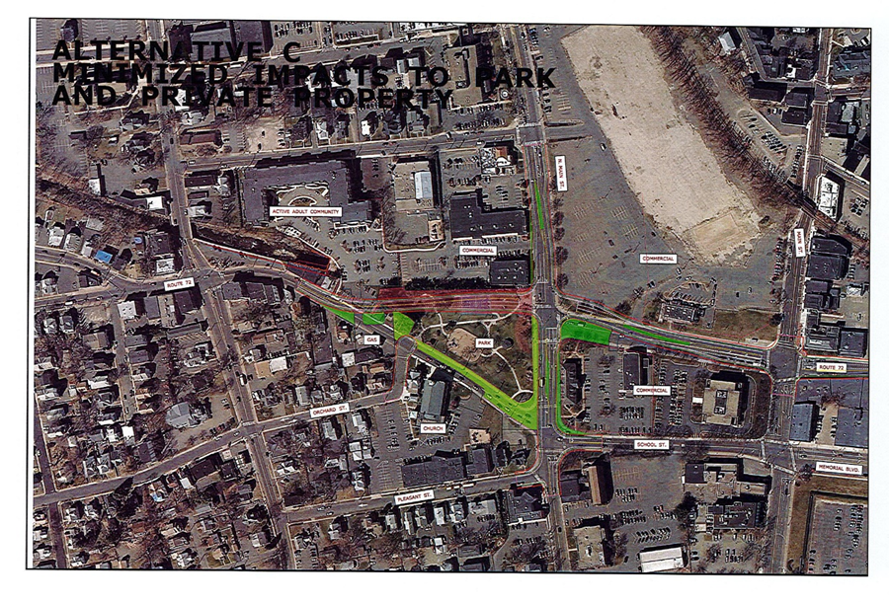
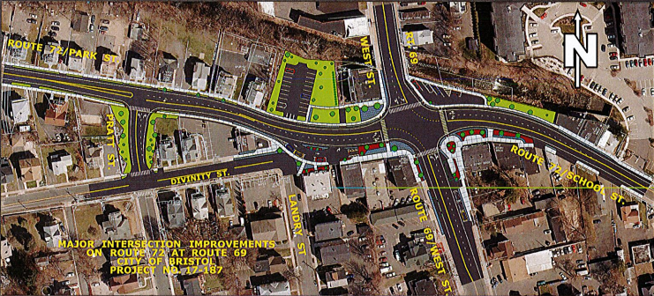
Notes:
Pic 1) Bracket Park (School St/North Main St)
Pic 2) Riverside Ave at Rt. 229
The section of memorial blvd linking these two locations currently has an on street, unprotected mobility/bike lane, which is we are currently planning to keep for this section of trail.
Toward the end of this section (near Rt 229), there is some ROW in between the River and Riverside Ave.

Slide 11
Project Scope and Timeline
February
Project Advisory Committee Meeting
March
1st Public Meeting (3/8/23)
Gather feedback on project details and existing conditions, identify shortcomings
April
Data collection (traffic, crash, etc.)
May–June
2nd Public Meeting
Share findings, collect input on potential routes
Identify routing options
Prepare potential implementation strategies
Final Report
Public engagement
Walk Audit (4/20/23)
On-going survey and outreach

Slide 12
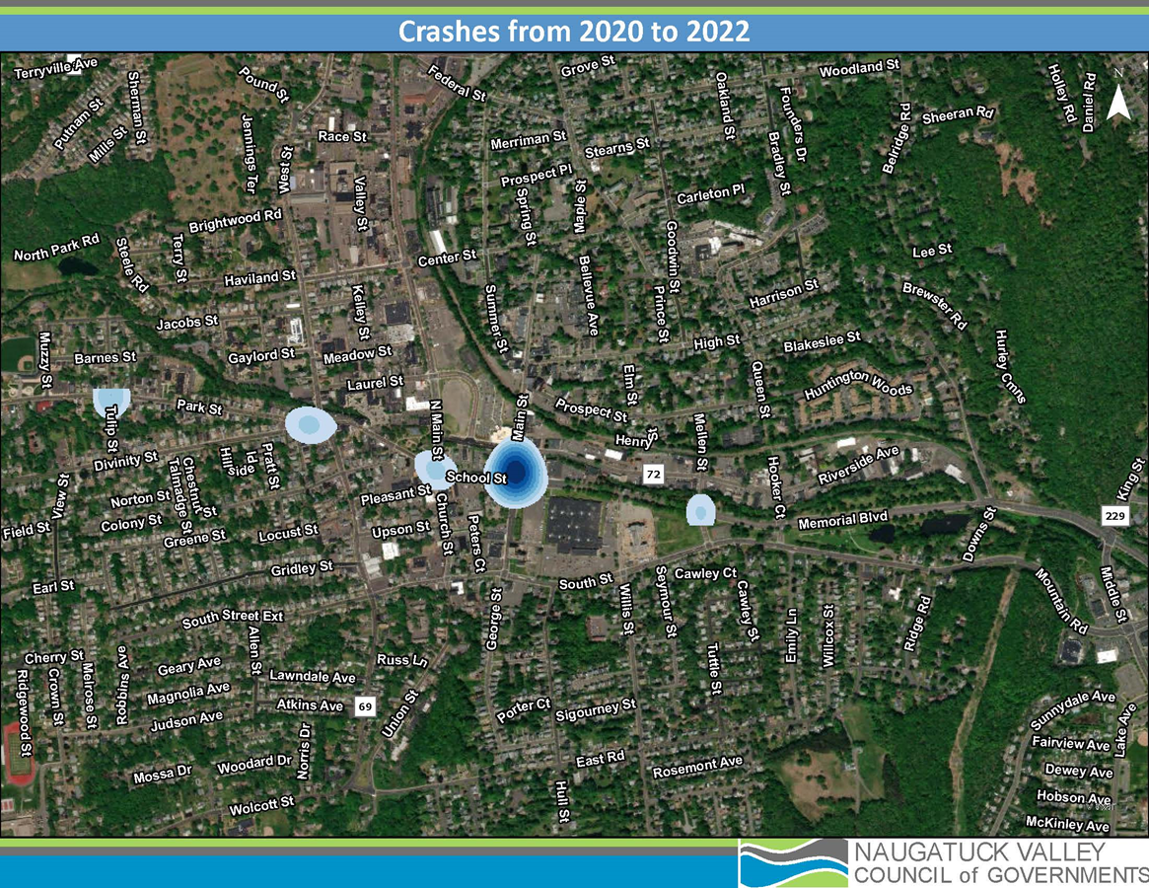
Notes:
Between 2020-2022, there were 111 total crashes on CT-72 between Rockwell Park and Memorial Boulevard (Park Street and School Street). 18 of these crashes resulted in possible injury, 9 in suspected minor injury and 1 in suspected serious injury. There was 1 pedestrian related crash, which resulted in possible injury. 43 crashes (including the pedestrian crash) occurred on the portion of CT-72 west of West Street. The other 68 crashes were on School Street. The relatively low crash frequency on this segment of CT-72 can likely be attributed to low speeds and narrow geometry. As the CTDOT plans to reroute CT-72, the crash frequency within this corridor will likely decrease.
Between 2020-2022, there were 38 crashes on Memorial Boulevard. In total, 4 crashes resulted in possible injury, and 6 resulted in suspected minor injury. There were no bike/pedestrian related crashes. It is encouraging that Memorial Boulevard’s crash rate is so low, however, the majority of this data was collected prior to the City of Bristol’s recent Memorial Boulevard project which included the installation of painted bike lanes.

Slide 13
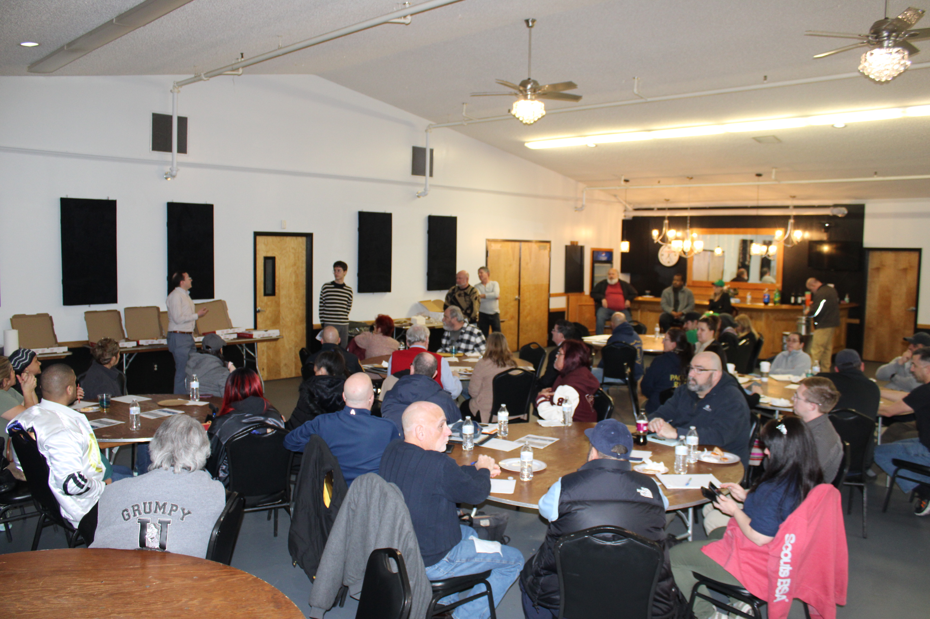
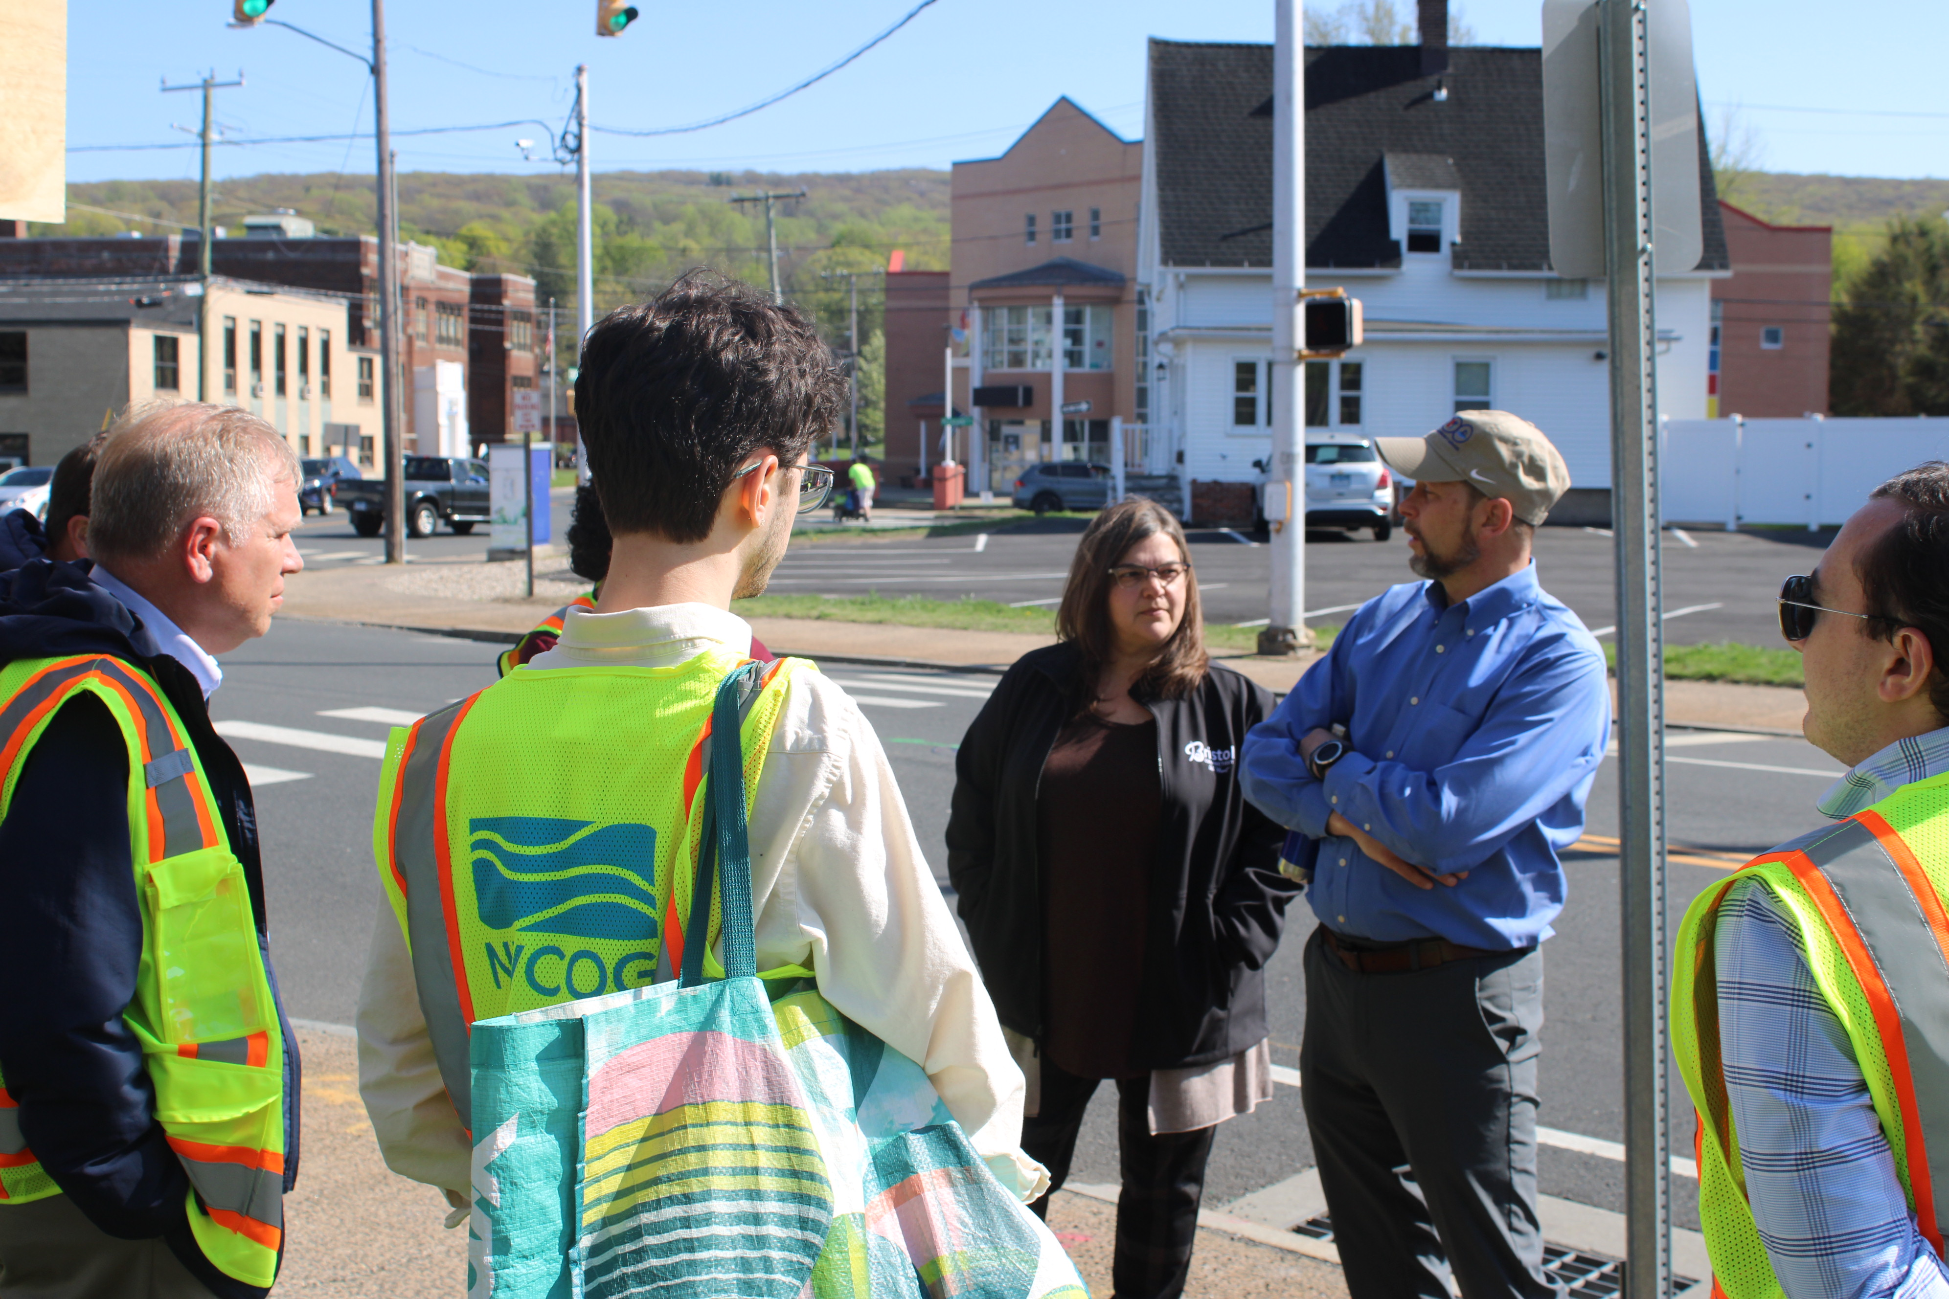
Public Engagement
Public Meeting #1
Walk Audit
West End Association Meetings
Online survey
Website page and social media outreach
Notes:
This has been the crux of this project!

Slide 15
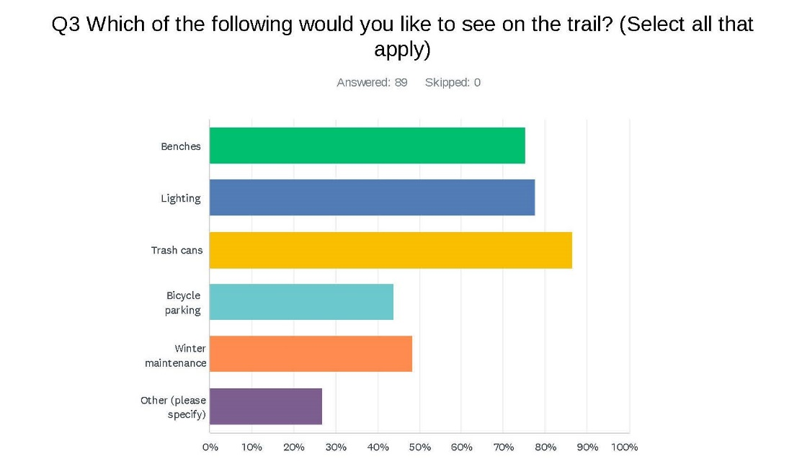
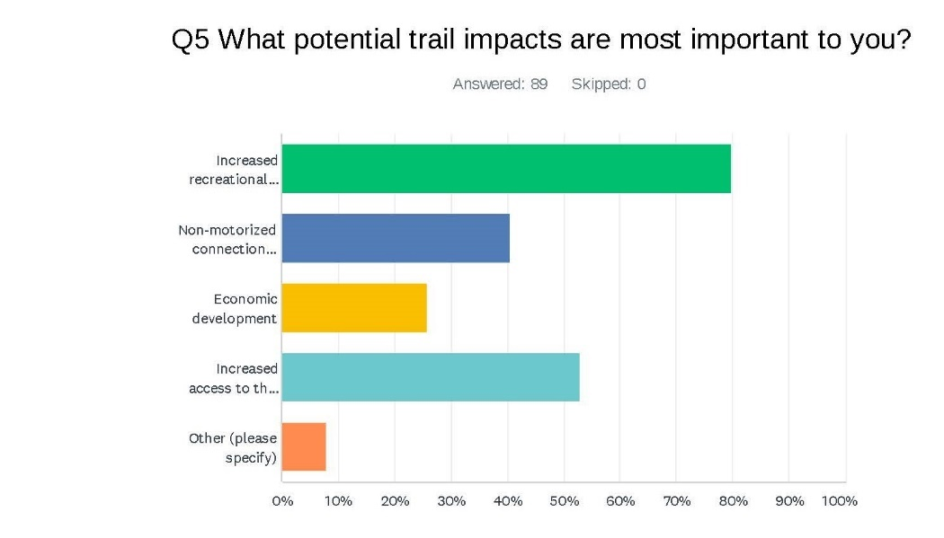
Notes:
Amount of investment from the community, excitement – these are the kinds of things that will actually move this project forward!!!

Slide 16
Routing Alternatives

Slide 17
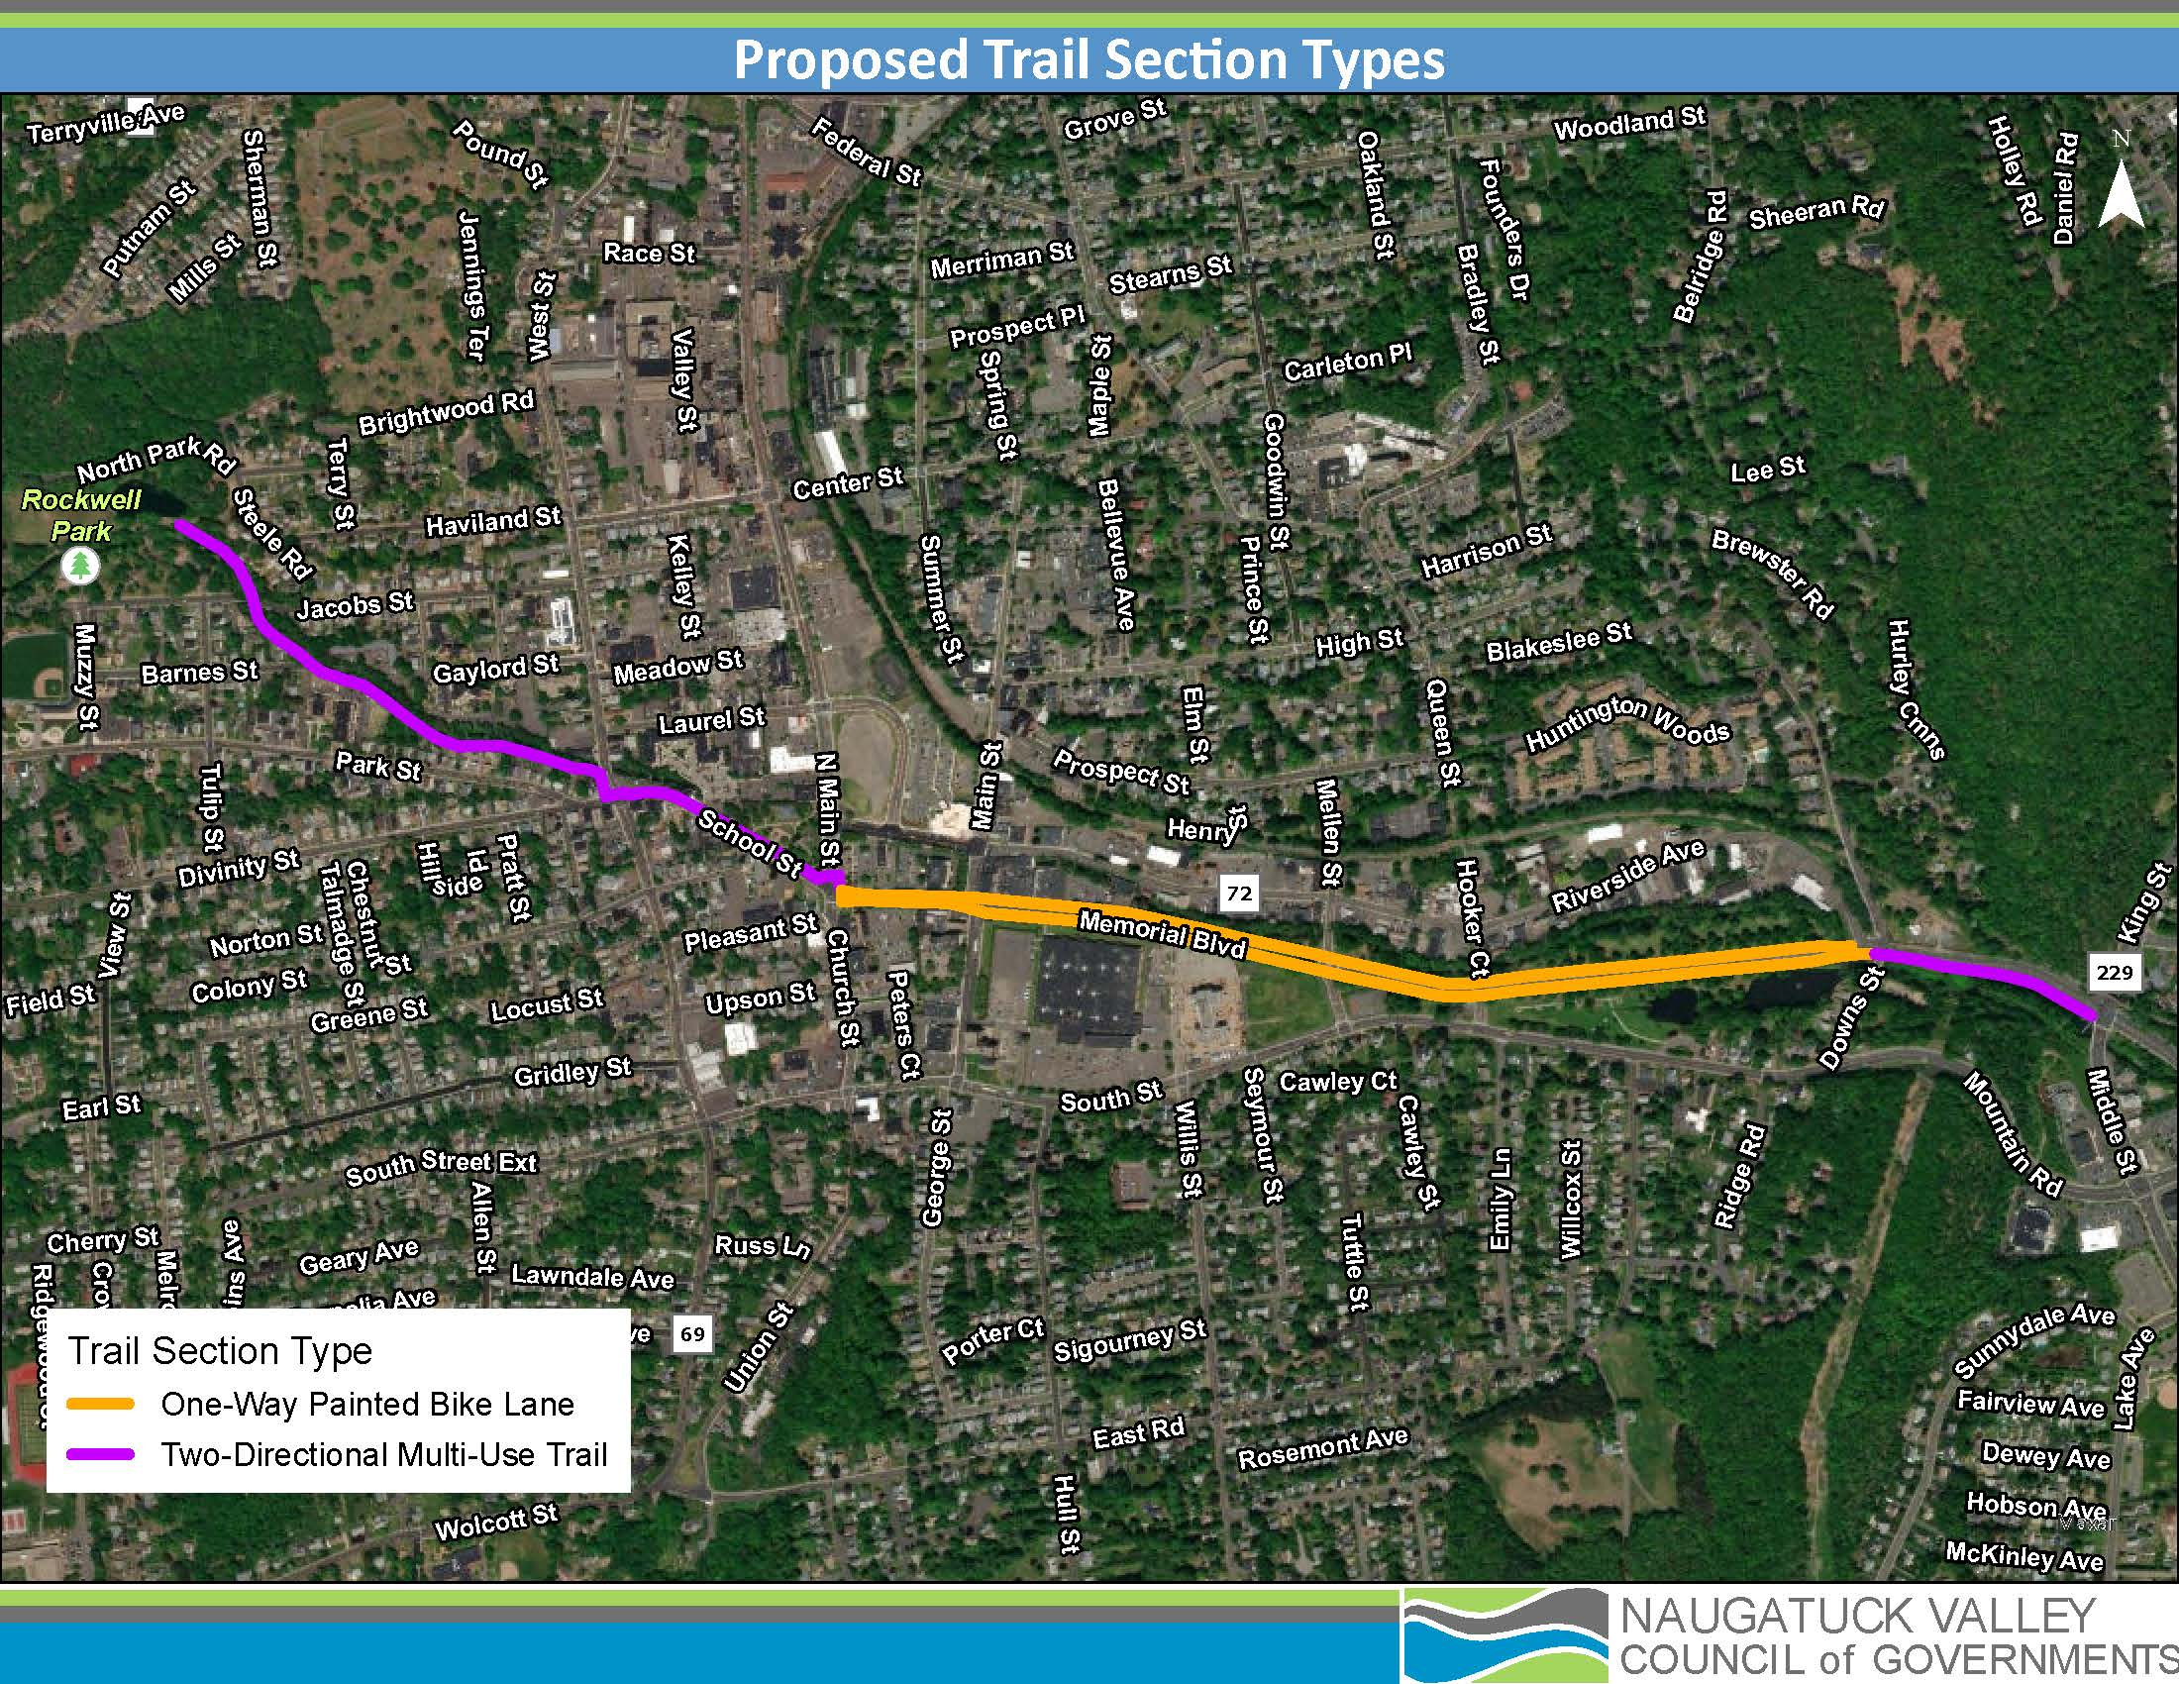
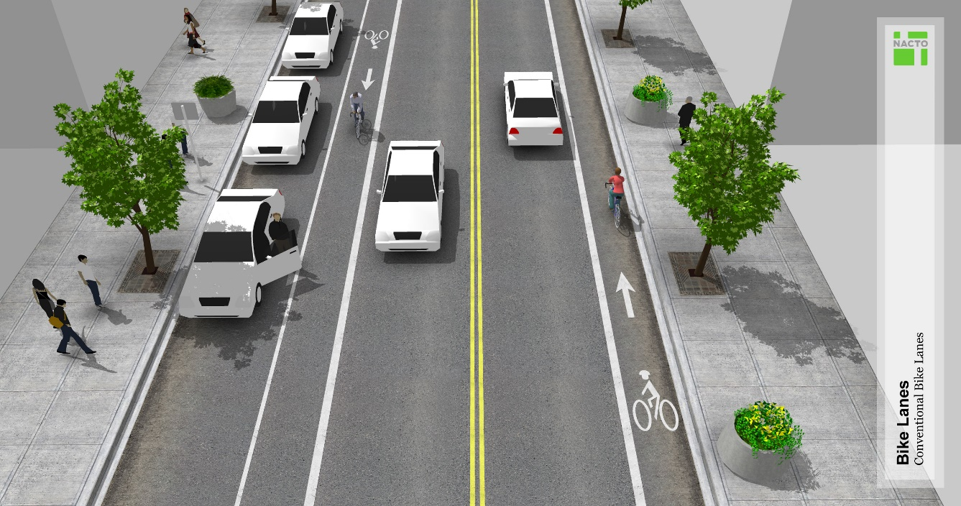
Alternative A
Multi-use trail along Pequabuck River from Rockwell Park to CT-72, continuing south of Brackett Park
From North Main Street/School Street to Route 229, conventional (unprotected) bike lanes
Notes:
More exact location of bridges will be decided on during design; two bridges likely near the Clara O’Connell School building; and another just west of West Street
Based off 72 realignment – part on school street may have to be on-street in the short term if this wants to happen before the Route 72 realignment

Slide 18
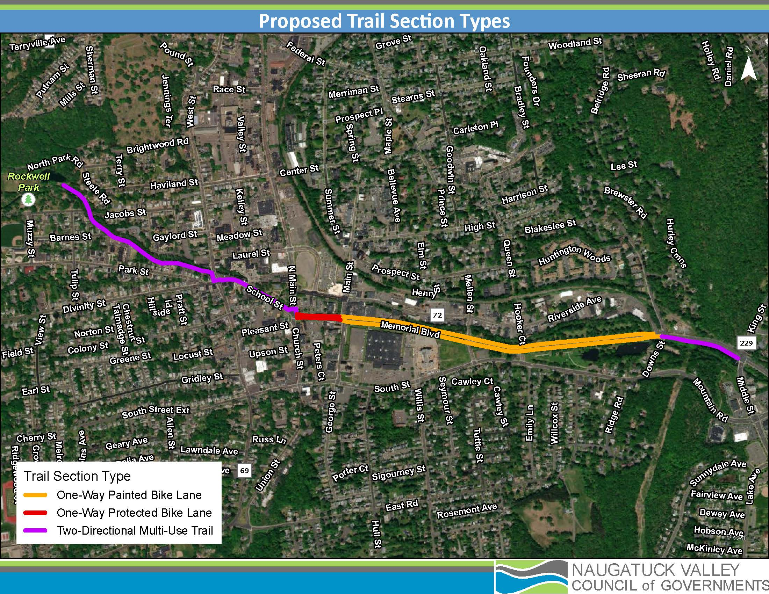
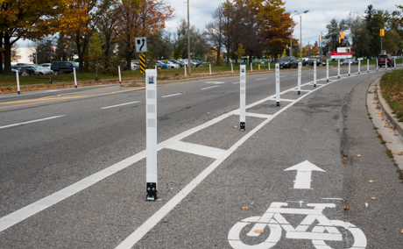
Alternative B
Multi-use trail along Pequabuck River from Rockwell Park to CT-72, continuing south of Brackett Park
From North Main Street to Main Street, protected bike lanes
Memorial Boulevard as is

Slide 20
Next Steps

Slide 21
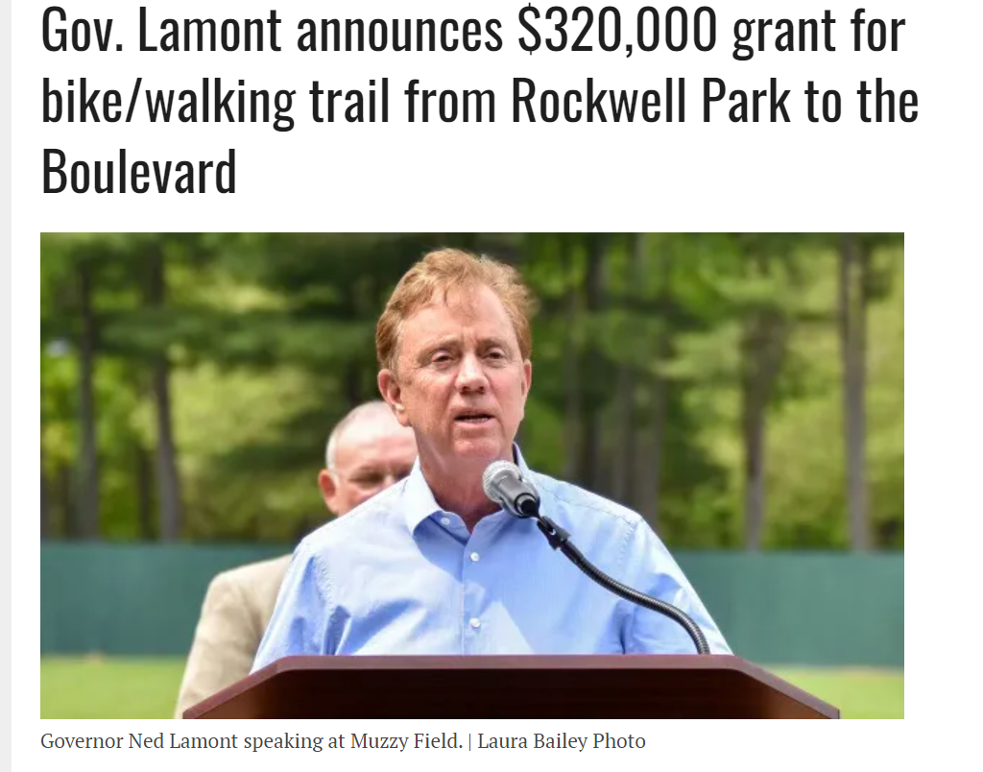
Implementation Strategies
CT DEEP Recreational Trails Program - $320,000 grant for design (2023-2026)
Future construction

Slide 22
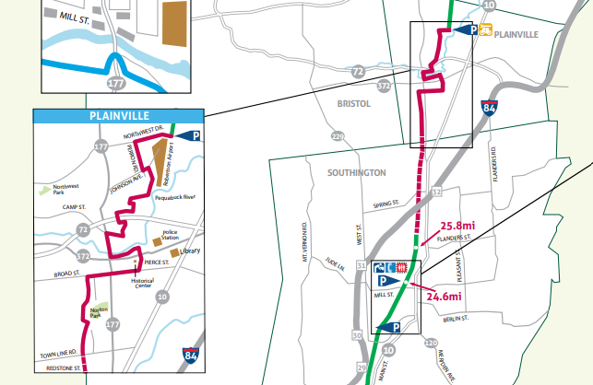
Phase 3: Route 229 to Farmington Canal Heritage Trail

Slide 23
Next Steps -- Report
Draft report will be available on the NVCOG Website
Public comment period -- please submit any additional questions or comments to Elliot Wareham, ewareham@nvcogct.gov or contactus@nvcogct.gov
The public comment period will be open for 30 days.
Language assistance is available
Submission of Final Report to City by 6/30
Notes:
Day after this meeting is done – we’ll post draft final report to our website.
Comments can be called in, emailed to me or contactus
Language assistance is available
Comments received by EOD 6/24 will be addressed in final report

Slide 24
Thank you!
Notes:
Insert QR code link for survey?

