Slide 1
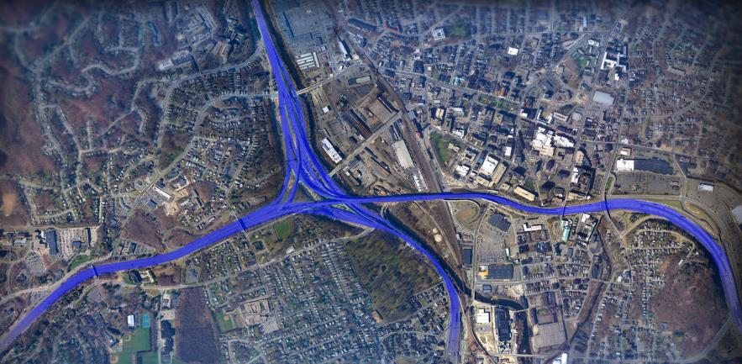
The New Mix: Long-term Plan for the I-84 - Route 8 “Mixmaster” Interchange
Notes:
SCOTT

Slide 2
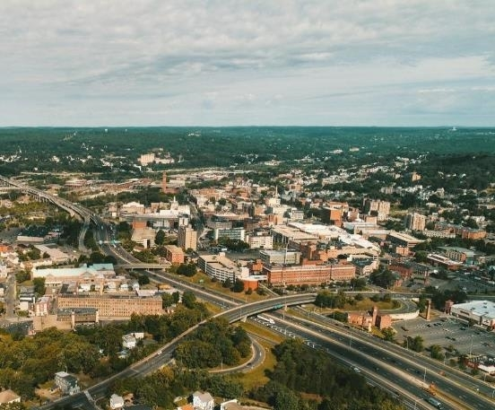
The New Mix Leadership Team
Connecticut Department of Transportation
Michael Calabrese, PE, Division Chief of Highway Design
Scott Roberts, PE, Project Manager
Jonathan Dean, PE, Project Engineer
HNTB Corporation
Jacob Argiro, PE, Project Manager
David Schweitzer, PE, Deputy Project Manager
Chris Fagan, PE, Project Engineer
Anna Mariotti, Public Information & Communications
Notes:
JAKE: I’d like to highlight the team members especially the ones that are new to the project since we last spoke. Mike Calabrese is the new Highway Division Chief, Scott and Jon have been with the project for many years now. As mentioned, I am the new project manager. You know our Deputy PM, David Schweitzer as he has been with the project since the beginning of the study. And we’ve added a Project Engineer, Chris Fagan, who isn’t joining us today as well as, Anna Mariotti our new public involvement coordinator.

Slide 3
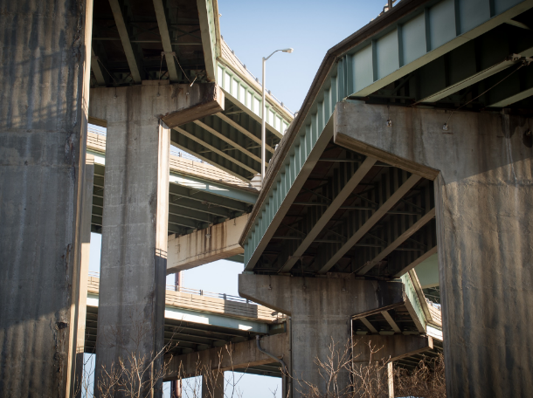
Agenda
Meeting protocols
New Mix Team
History of the Mixmaster
New Mix Program
Public Involvement
Planning & Environmental Linkages and the Project Advisory Committee
Questions & Comments
Notes:
JAKE: We’d like to share with you the presentation that we will be presenting to the stakeholders of this project.
Good afternoon, I’m Jacob Argiro from HNTB, the DOT’s, Consultant Project Manager for this project. Today we’d like to talk about the changes to the project team, give you a brief overview of the history of the Mixmaster interchange, discuss the past and future efforts of the New Mix Program, talk about our approach to the public involvement process and then open it up for general discussion.

Slide 4
Zoom Meeting Protocols
To ensure meetings are productive, friendly, and efficient, we request that attendees adhere to the following:
Use respectful language & standard, professional meeting decorum.
Remain muted when not speaking.
Hold questions until after the presentation.
Please note that in the rare event that a backlog of pending questions and/or comments occurs we will ask that attendees limit initial comments to 2 minutes so that everyone has a chance to speak. Once everyone has had the opportunity to speak, we will then allow attendees who have additional comments more time.
Notes:
Attendees will have many other opportunities outside of this meeting to ask questions and leave comments: emails, phone calls, through the website which will launch later this summer.

Slide 5
Mixmaster Reconstruction Program Timeline (2017-Present)
Fiscal Warning from CTDOT 1/1/2018
NVCOG Meeting 10/23/2017
I-84 WB Auxiliary
Lane Added to
Rehab Project 1/14/2021
Transition to PEL
Study Approach 4/1/2019
2nd Half, 2017
1st Half, 2018
2nd Half, 2018
1st Half, 2019
2nd Half, 2019
1st Half, 2020
2nd Half, 2020
1st Half, 2021
July 2017
Reduced Scope; Fiscally Constrained Alternatives Development (Rehabilitation in 2045)
Potential Early Action Studies
May 2021
Conceptual Alternatives Development
(2045 Replacement Alternatives)
Traffic Analysis, Constructability, and Structural Layout
Mayor O'Leary
Meeting 7/18/2017
Finalization of Needs and Deficiencies Study 8/12/2020
State Delegation Meeting
11/9/2017
Meetings with Regional Chamber of Commerce, Various City Departments November 2017
Notes:
SCOTT

Slide 6
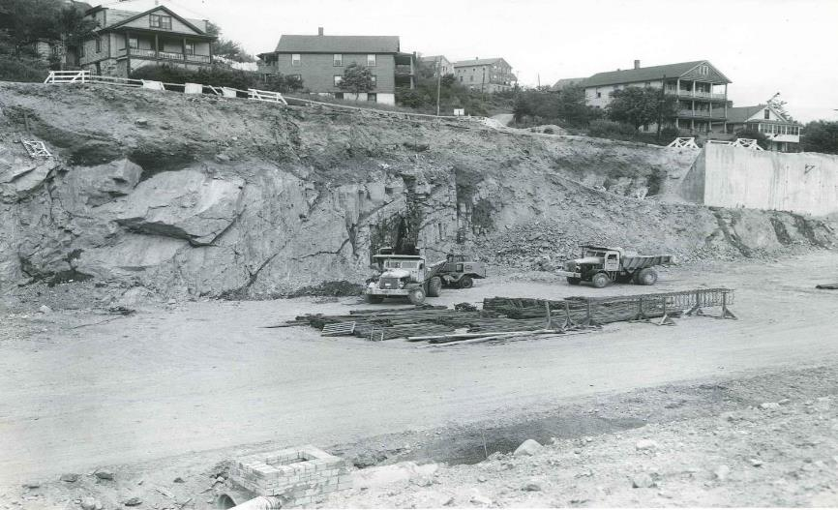
History of the Mixmaster
Notes:
DAVID: IMAGE: June 14, 1965. South end of Charles Street wall looking north easterly from east side of Route eight.

Slide 7
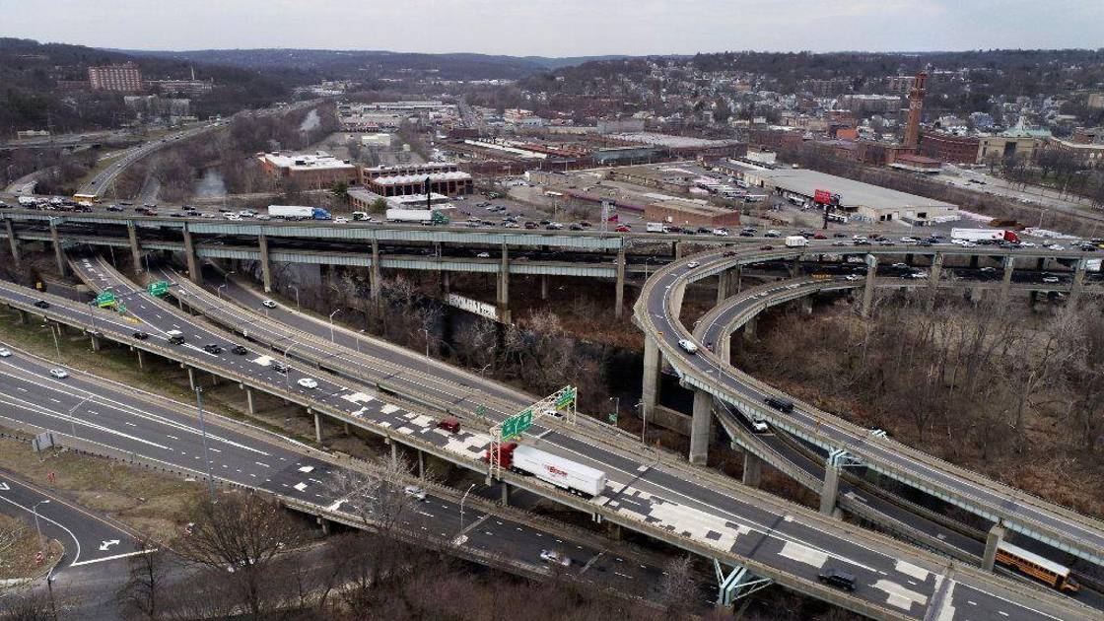
Existing Mixmaster
Notes:
DAVID

Slide 8
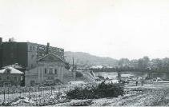
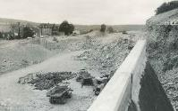
Mixmaster History (Original Construction)
Projects | Construction Start/End
Construction of Interstate 84 (west of Mixmaster) | 1962 – 1965
Relocation of Connecticut Route 8 (north of Mixmaster) | 1963 – 1965
Relocation of Connecticut Route 8 (north of Mixmaster) | 1964 – 1966
Interstate 84 and Relocation of Connecticut Route 8 (Mixmaster Substructure) | 1964 – 1965
Relocation of Connecticut Route 8 and Grading on Interstate 84 (Route 8 south of Mixmaster) | 1964 – 1967
Interstate 84 and Relocation of Connecticut Route 8 (Mixmaster Superstructure) | 1965 – 1968
Construction of Interstate 84 (east of Mixmaster) | 1976 – 1981
Fact: 10-12 projects had to be done in order to complete the initial structure at an approximate cost of $48M.
Notes:
DAVID Fact: 10-12 projects had to be done in order to complete the initial structure at an approximate cost of $48M.
The Mixmaster was constructed through a series of projects spanning almost 20 years completed in 1981.

Slide 9
Mixmaster History (Recent Efforts)
Recent Projects | Construction Start/End
I-84/Route 8 Interchange Structural Steel Repairs | 1988 – 1989
Rehabilitation of Bridge Nos. 03191A, 03196, and I-84 over Naugatuck River, Railroad (Deck patching, expansion joints) | 1994 – 1995
Bridge Painting, Seismic Retrofit, and Illumination, I-84 over Route 8, Naugatuck River, Railroad | 1995 – 1997
I-84/Route 8 Interchange Pier Cap and Deck Joint Repair | 2005
I-84 Widening Project | 2015 – 2020
I-84/Route 8 Interchange Rehabilitation (Structural Steel Repairs & Continual Deck Patching) | On-going
Notes:
DAVID Continuous efforts have been made and are currently ongoing to maintain the safety and functionality of this structure.
Mixmaster Study Area includes over 60 structures. The bridges and roadways have required maintenance and repairs over the years, including concrete, steel and deck repairs. The bridges have also undergone a seismic retrofit. To the east a widening project was recently completed on I-84 that now has three (3) through lanes in each direction between Hartford and Waterbury.
The New Mix project team met with these stakeholders prior to a brief pause of the project in 2018.
Stakeholder Meetings Completed in 2017:
Mayor’s Office
NVCOG
City Departments (Planning, Engineering, DPW, Economic Development)
Regional Chamber of Commerce
Police Department
Fire Department
St. Mary’s Hospital
Palace Theater
Waterbury Hospital

Slide 10
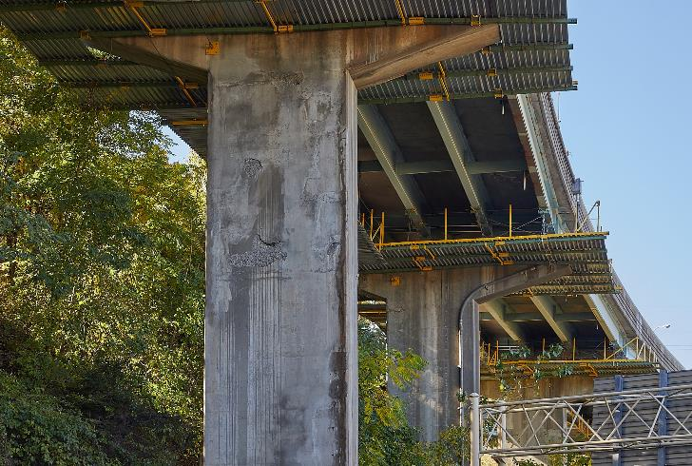
Rehabilitation of Mixmaster
Current Major Rehabilitation, in Construction Spring 2018-Fall 2022
Deck Replacements/Repairs
Steel Strengthening/Repairs
Concrete Repairs
Pavement Improvement
Guiderail Replacement
Barrier Wall Modifications
Temporary Bypass
Notes:
DAVID
The Mixmaster is currently undergoing a major rehabilitation that will add 25 years of service life until the reconstruction
This includes the Deck Replacements on Route 8 as well as deck repairs to the other bridges, also steel repairs and strengthening along with concrete repairs.

Slide 11
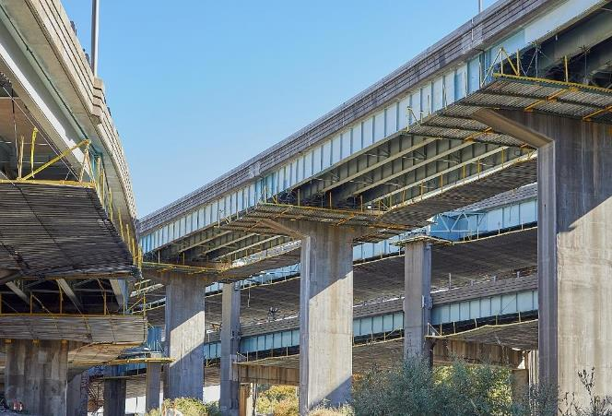
Existing Needs & Deficiencies
Age of Structures
Dated Safety & Operational Standards
Structural Deficiencies
Geometric Deficiencies​
Traffic congestion​
Stacked Structures​
Maintenance Costs
Notes:
DAVID: State of the interchange today. STRUCTURAL AND GEOMETRIC DEFICIENCIES INCLUDE:
Left hand entrances and exits
Narrow or non-existent shoulders/break down lanes
Areas that demand drivers merge across many lanes
Lifespan of decks, substructures and steel
Interchange spacing
Fatigue related details in nonredundant spans

Slide 12
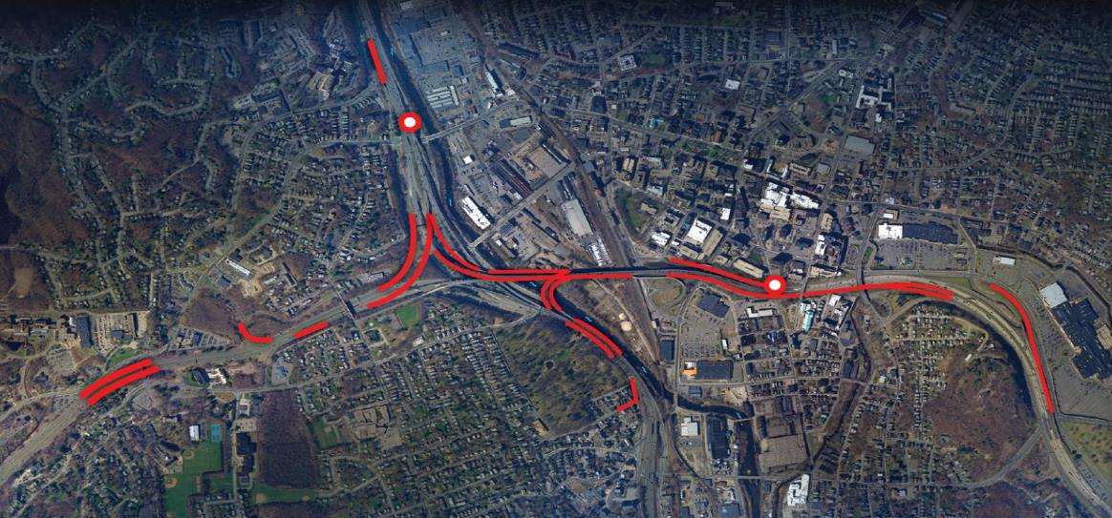
Mixmaster Crash Data (2015 – present)
Legend
Higher crash rate
Fatality
Notes:
DAVID: Red shows areas where the rate are crashes are higher than normal due to geometric deficiencies such as lack of shoulders/break down lanes, and left-hand entrances and exits.

Slide 13
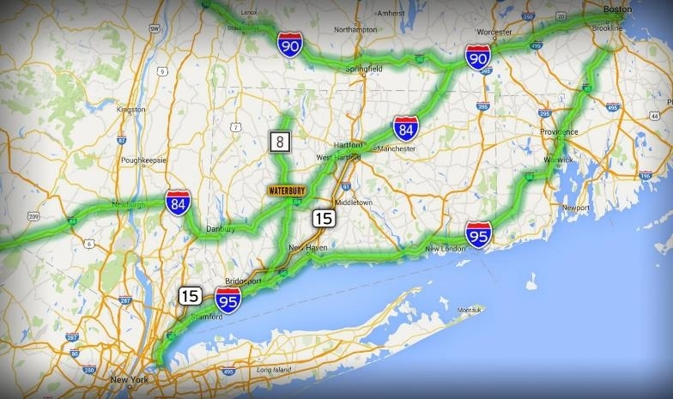
Regional Project Overview
Gateway to New England
Limited East/West Routes
Notes:
DAVID: A vital transportation corridor for CT and the region—THEN TURN OVER TO JAKE

Slide 14
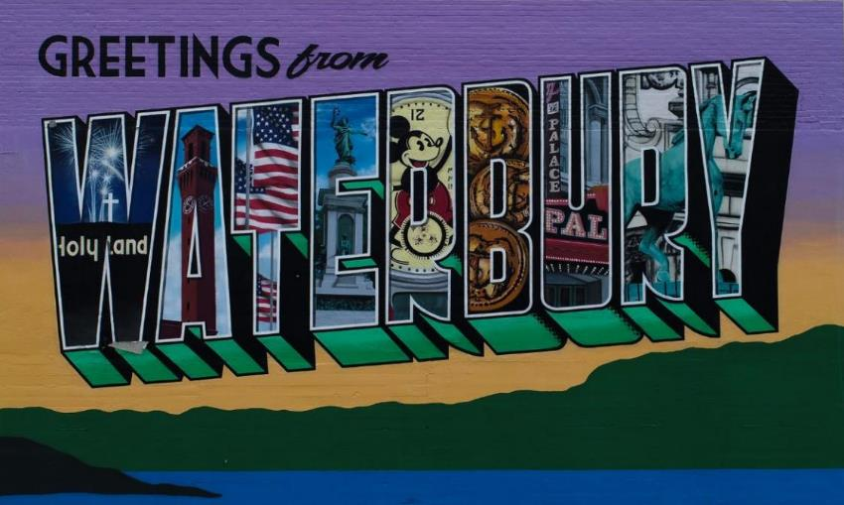
The New Mix
Notes:
JAKE: The long-term solution for the Mixmaster interchange will be defined through the New Mix program.

Slide 15
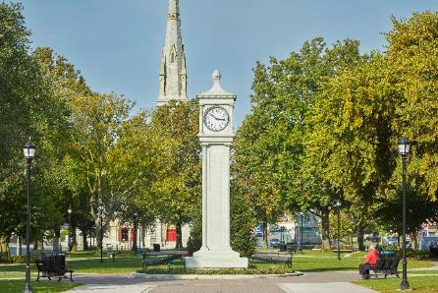
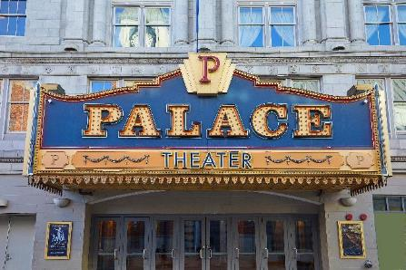
The New Mix Program
Long-term plan for the future of the Mixmaster
Projects may occur over time
Analyze rehabilitation and replacement options that:
Modernize
Improve safety & functionality
Improve function of local road network & the interchange
Reduce congestion
Aligned with economic development & community context
Notes:
JAKE: The New Mix program is a long-term planning study that looks to find a solution as to how to reconstruct the interchange, as it reaching the end of its lifespan. It is anticipated that this will be phased over time with an overall goal to modernize, improve safety and functionality, reduce congestion and align the project with the City’s economic development and community goals.

Slide 16
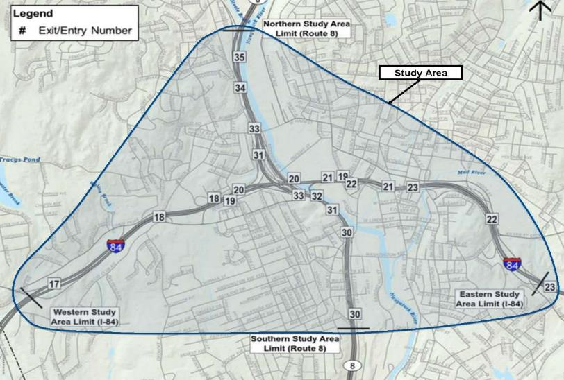
The New Mix Study Area
Notes:
JAKE: Study area extends beyond the interchange in order to examine a wide range of design options. Considerations for setting the study area included the entrance/exit limits for the interchange, major arterial intersections, as well as cultural and historical resources. Local road function with the interchange will also be examined.

Slide 17
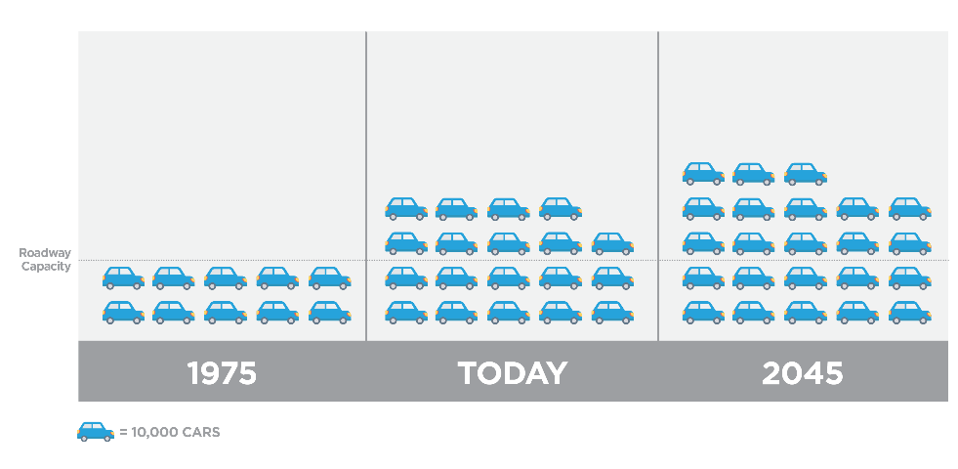
Mixmaster Traffic Volumes
Notes:
JAKE: The Mixmaster was designed to accommodate approximately 100,000 motor vehicle trips per day (predicted 1975 traffic volume). Now: 190,000 motor vehicle trips occur along the interchange each day. 2045: estimated 225,000 motor vehicle trips per day. Combined with operational deficiencies, creates less than ideal conditions.
Additionally, through our study, we found that approximately 35% of the motor vehicles enter and exit the interchange within the study area showing that people are using the interchange to get from one side of the City to the other.

Slide 18
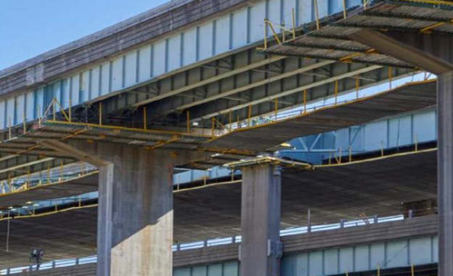
2018: Results of the 2045 Rehabilitation Analysis
Estimated cost of $1B vs. 2B replacement which would not address:
Traffic volumes that far exceed the interchange’s design capacity
Sub-standard shoulders & lack of breakdown lanes
Left hand entrances and exits
Modern design & safety standards such as sight distance, sharpness of curves
Notes:
JAKE: The existing structure, which is currently undergoing a major rehabilitation, is anticipated to reach the end of its projected service life in approximately 25 years. At that point, the concrete deck on the I-84 structures will need to be replaced.
continued rehabilitation and repair of vital structural components will no longer make sense from an economic or structural life-cycle perspective, and replacement will likely be the most logical long-term solution.
With the intensive rehabilitation project scheduled to begin, the Connecticut Department of Transportation (CTDOT) turned attention to longer-term planning for the Mixmaster in 2017.
In early 2018, further development of Mixmaster replacement options was put on hiatus due to state budget issues.
During hiatus, CTDOT explored another major rehabilitation in lieu replacing the Mixmaster by 2045.
The 2045 Rehabilitation Analysis explored a complete replacement of bridge decks on the I84 portion of the interchange.

Slide 19
Potential Timing & Breakout Project Schedule
Potential Early Action Projects
Environmental Studies
Initiate Projects
Construction
Near-term Projects
Environmental Studies
Initiate Projects
Construction
Long-term Projects
Initiate Projects
Phase 1
Construction
Environmental Studies
Initiate Projects
Phase 2
Construction
2020
2022
Mid
2020s
Early
2030s
Mid
2030s
Early
2040s
Mid
2040s
Notes:
JAKE: We are at the very early planning stages of a long-term, complicated and large project. While we are looking at various replacement and rehabilitation options for the Mixmaster, all options include phasing the overall large project into smaller, more manageable projects.
Phased project approach is more manageable because:
- allows for preparation and distribution of funding for this other major projects in the State
- less intense traffic impacts by constructing improvements to lessen traffic on the interchange
-

Slide 20
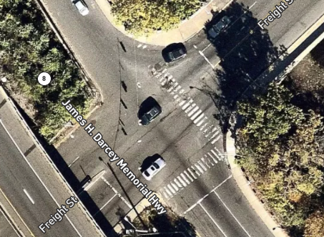
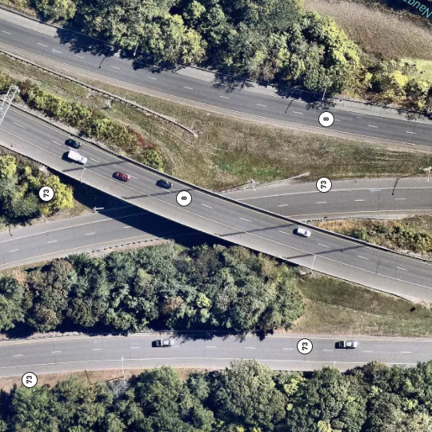
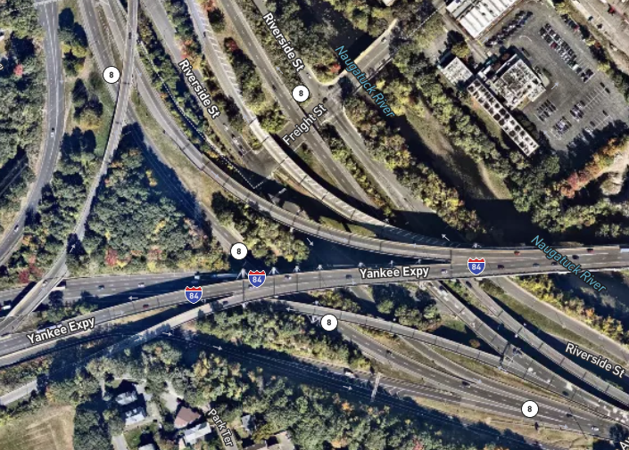
General Nature of Anticipated Projects
Early Action Projects
Improvements to local roads and intersections
Near-Term Projects
Improvements to highway approaching Mixmaster compatible with Long-Term Projects
Long-Term Projects
Reconstruction of core interchange structures
Notes:
JAKE: What are the types of projects that we are talking about?
Early Action Projects.
Generally, focus on high impact local road/intersection improvements that can reduce the volumes using the interchange to get across town
Near-term Projects
Projects generally on the outer legs of the interchange that can be initiated before the core of the interchange is reconstructed.
Long-term Projects
Projects that include Interstate 84, Route 8, and their system connections to be completed by mid 2040s. These projects focus on the core of the interchange

Slide 21
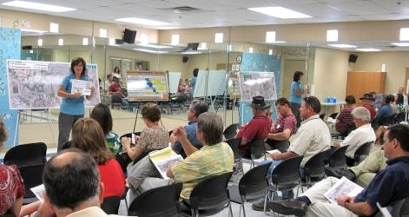
The New Mix Public Involvement
Notes:
ANNA: Our intent is to be inclusive in our outreach, reaching a wide-range of Waterbury’s population and providing information-sharing and feedback opportunities for all. Understanding that some people, groups, and organizations may want to be more involved in planning that others, but that everyone deserves the opportunity to understand the New Mix project, be informed, and have the opportunity to provide feedback, we have developed a multi-layered approach for public involvement.

Slide 22
The New Mix Project Participation
Local Community Organizations
Public/ Stakeholders
State and Local Elected Officials
Input
City of Waterbury
Region, Towns/Cities
Interstate Freight Groups and Motor Carriers
Notes:
ANNA: This multi-layered approach keeps all informed & provides all with opportunities to weigh in and provide feedback no matter what time commitment those groups/individuals have to share or would like to commit.
Residents & businesses (especially immediate abutters)
City of Waterbury Mayor’s office
Community & neighborhood organizations
Large employers
Local, State, and Federal Elected Officials
Local and Regional Organizations

Slide 23
The New Mix Project Participation
Stakeholder
Meetings Include
Mayor of Waterbury
Waterbury Board of Alders
NVCOG
City Department Heads
Neighborhood organizations
Chamber of Commerce & Economic Development
Large Employers
Environmental Groups
Community Organizations
Title VI Environmental Justice
Stakeholder Meetings
Identify PAC Participants
PAC Meetings
Public Meetings
Notes:
ANNA: CTDOT has taken time to develop a thoughtful approach to accomplish this inclusive & multi-leveled approach. Multi-layered approach includes:
--Stakeholder group outreach. We’ve developed stakeholder groupings, as shown in the slide, that range from Community & Neighborhood organizations to Large Employers. Each stakeholder group consists of numerous organizations, employers, and/or neighborhood groups. Each stakeholder group will be briefed and engaged about the New Mix project early on (beginning now as we launch) and periodically as the project continues.
--Project Advisory Committee (PAC)- Each stakeholder group consists of numerous organizations, neighborhood groups, large employers, and elected officials. Some may want to have more involvement in the New Mix project than others. For those who would like to be more involved, we will form a Project Advisory Committee that will meet on a much more frequent timeframe throughout the project.
--Public meetings. In addition to stakeholder group meetings and PAC meetings, we will regularly host public meetings in an attempt to be sure to reach those who have questions, interest, and/or feedback on the project have an opportunity to do so.

Slide 24
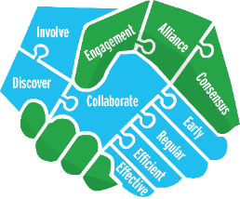
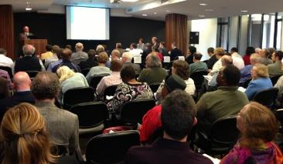
The New Mix Public Involvement
Communication methods will be multi-faceted and include:
Newsletters & updates via email (including sharing such information through community organizations)
Social Media
Program website with question & comment forms
Public meetings (virtual and after pandemic, both virtual and in-person)
Project Advisory Committee
Input
Notes:
ANNA: In addition to the multi-layered approach to public outreach providing many opportunities for public involvement at varying levels, we will also use many platforms to keep the public updated even if they prefer to not attend meetings.

Slide 25
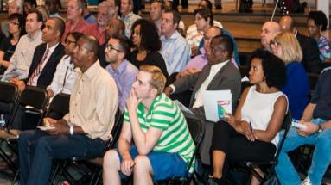
Public Involvement: Planning & Environmental Linkages, Project Advisory Committee Details
Notes:
Jon Dean

Slide 26
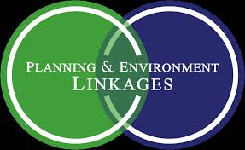
What is the Planning & Environmental Linkages Process?
The Planning and Environment Linkages process (PEL) incorporates environmental, community, and economic goals in the very early planning and design phases of transportation projects/programs.
PEL process was developed by the Federal Highway Administration (FHWA).
CTDOT will utilize the PEL approach for the New Mix’s early planning process.
Through PEL, CTDOT will collaborate with the community to develop a vision for the needed transportation improvements of the New Mix, being mindful of the potential impacts on the community and environment within and surrounding Waterbury.
Notes:
Jon Dean: PEL is a TOOL. It is a tool that provides a pathway for early collaboration & coordination. Using the PEL approach, CTDOT will develop a vision for the needed transportation improvements of the NEW MIX, while being mindful of the potential impacts on the community and environment within and surrounding Waterbury.

Slide 27
Public Involvement & the PEL Approach
Via various platforms, any member of the community will have opportunities to learn, ask questions, and provide input on the New Mix Program. All community input, no matter how it is received, will be weighed the same.
Throughout the PEL process, CTDOT will collaborate with the community to:
Define the program’s Purpose & Need and Goals & Objectives
Identify transportation issues
Highlight community & environmental concerns
Determine priorities
Identify and evaluate solutions (early design concepts) against the variables mentioned above, leading to the narrowing down of final design options
Notes:
Jon Dean: The purpose is to delve deep early on to problem solve, prevent re-work, saving time and money….but also developing a project that meets transportation needs while also fitting within the community, economic context. PEL aims to create a more unified decision-making process in collaboration w/ public and stakeholders, reduce duplication of efforts, and result in more informed decisions.

Slide 28
Project Advisory Committee Detail & Timeline
The Project Advisory Committee (PAC) is an important component of PEL
Serving on the PAC provides opportunity for those who want to be more involved in the PEL study.
Serving on the PAC requires a bit more time and participation, but is not intended to be time consuming
Anticipate 4-7 PAC meetings over a year and a half
Project Team Tasks
PAC Meetings
Notes:
Jon Dean: PAC membership is anticipated to represent a cross section of interests including groups that will be directly impacted by the program. Over the next year and a half, we anticipate there will be approximately 4-7 PAC meetings, each no longer than 1.5 hours; but typically limited to one hour. PLEASE LET US KNOW IF YOU WOULD LIKE TO BE CONSIDERED TO SERVE ON THE PAC. Reminder: PAC members will be more intimately involved in the early study progress, but ALL public input will be weighed the same.

Slide 29
Next Steps!
Please let us know if you would like to be considered to serve on the PAC.
Provide us your email if you would like to receive New Mix updates, including notice of public meetings and program news!
The New Mix website will launch in late summer/early fall. The website will provide another avenue through which the public can ask questions and leave comments regarding the New Mix program.
Prior to the New Mix website launch, questions and comment can be emailed to amariotti@hntb.com
Notes:
Jon Dean: PAC membership is anticipated to represent a cross section of interests including groups that will be directly impacted by the program. Over the next year and a half, we anticipate there will be approximately 4-7 PAC meetings, each no longer than 1.5 hours; but typically limited to one hour. PLEASE LET US KNOW IF YOU ARE INTERESTED IN SERVING ON THE PAC.

Slide 30
Questions & Comments
Notes:
JON: QUESTIONS & COMMENTS-INQUIRE IF NVCOG STAFFER WOULD LIKE TO SERVE ON PAC

